Slide 1
Perceiver & Perceiver IO
Implementation and Experimental Analysis
Francesco Gigli · Corso Vignoli
Università degli Studi di Firenze | Course B031278 — Deep Learning

Slide 2
1
Introduction
2
Perceiver
3
Experiments: Perceiver
4
Perceiver IO
5
Experiments: Perceiver IO
6
Conclusion
F. Gigli C. Vignoli Perceiver & Perceiver IO

Slide 3
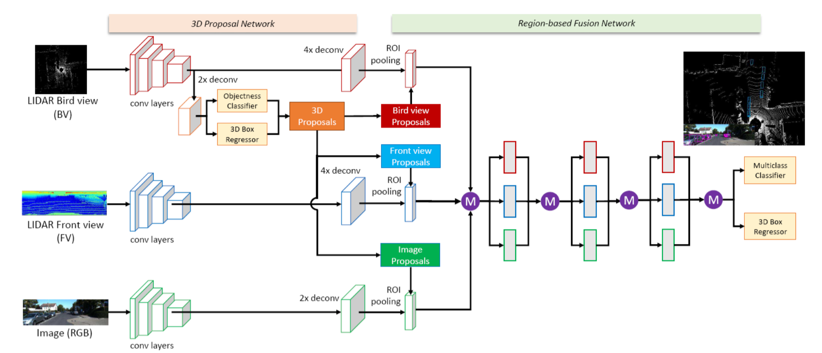
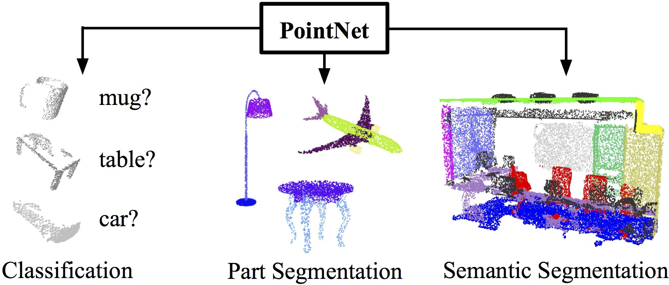
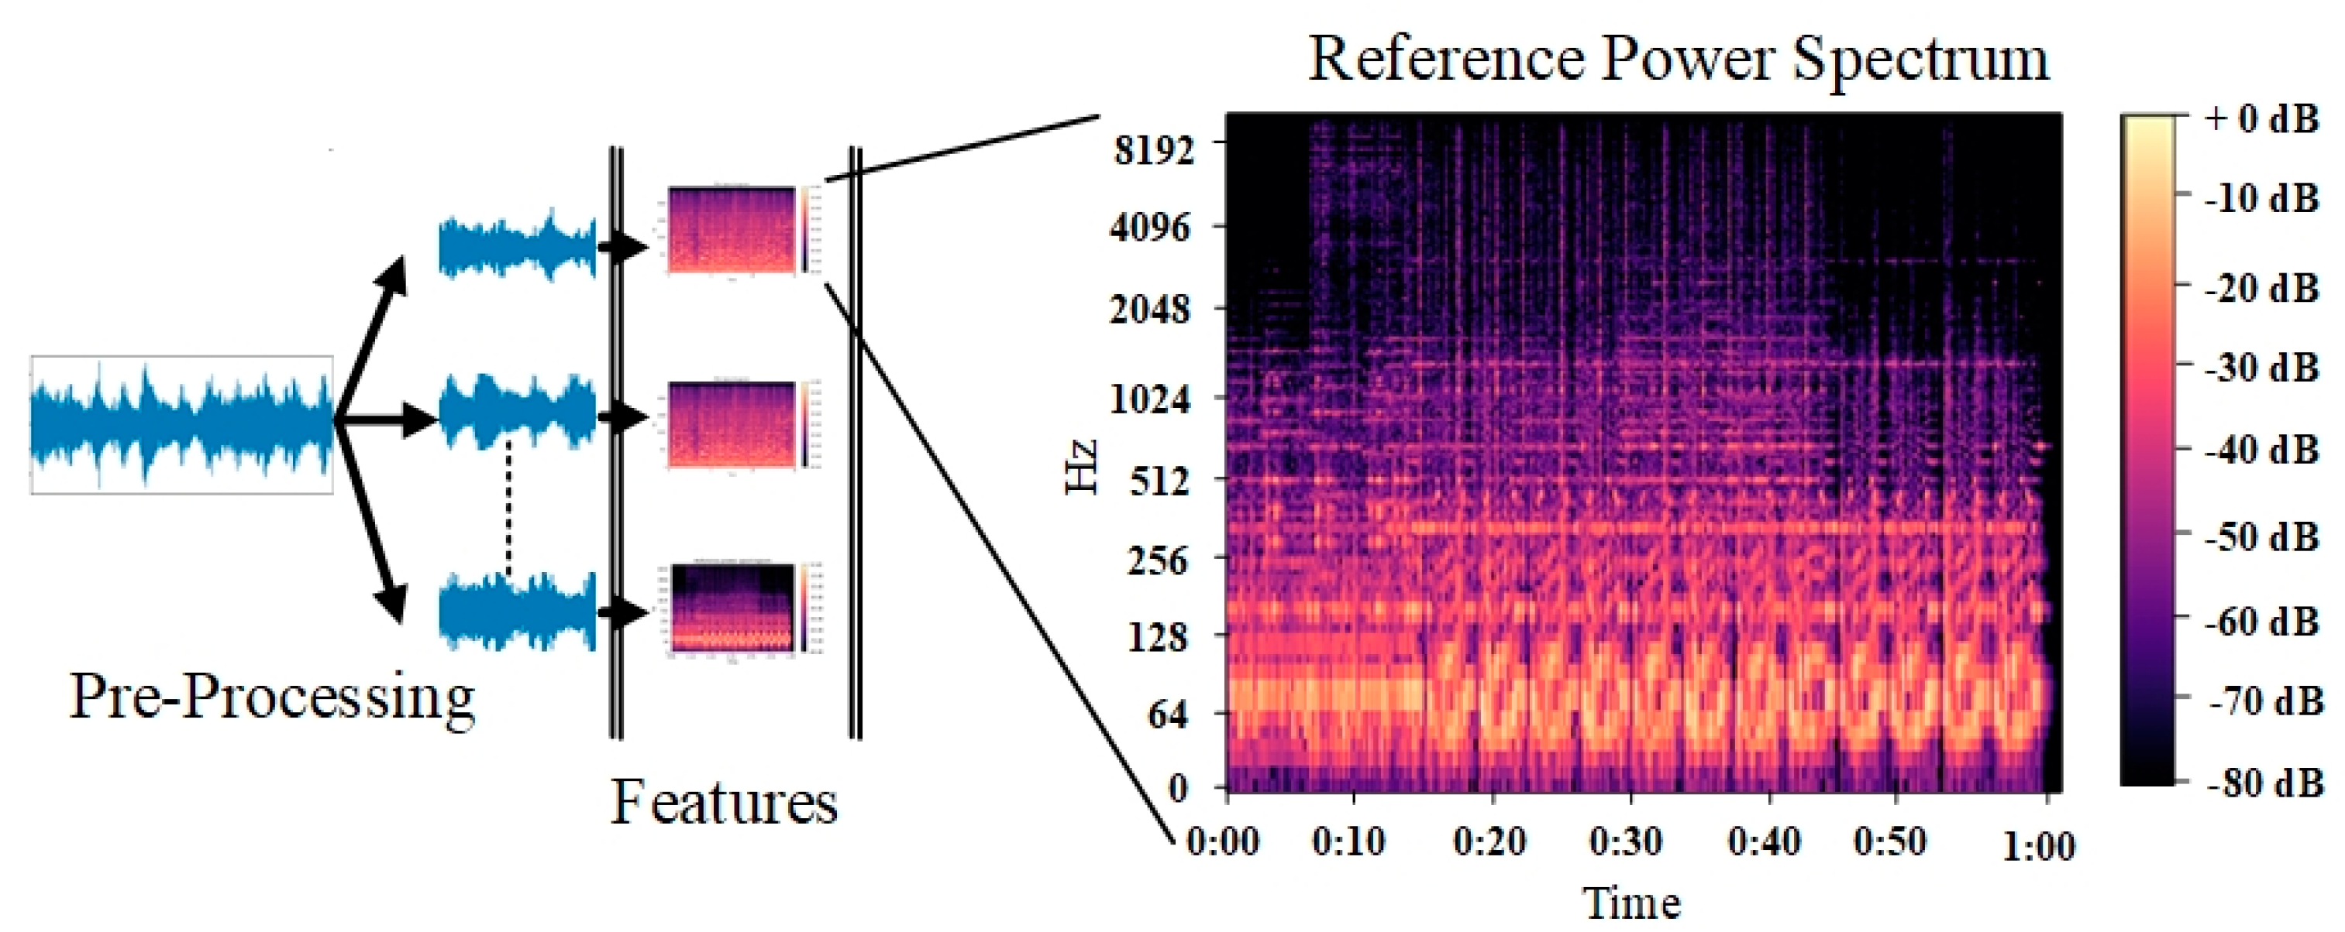
The Problem: Modality-Specific Architectures
One modality, one architecture
Images
→ CNNs
Text
→ Transformers
Audio
→ RNNs / 1D-CNN
Point Clouds
→ PointNet
Each data type is usually paired with a dedicated model and domain-specific assumptions about structure.
Can one architecture handle arbitrary inputs?
F. Gigli C. Vignoli Perceiver & Perceiver IO

Slide 4
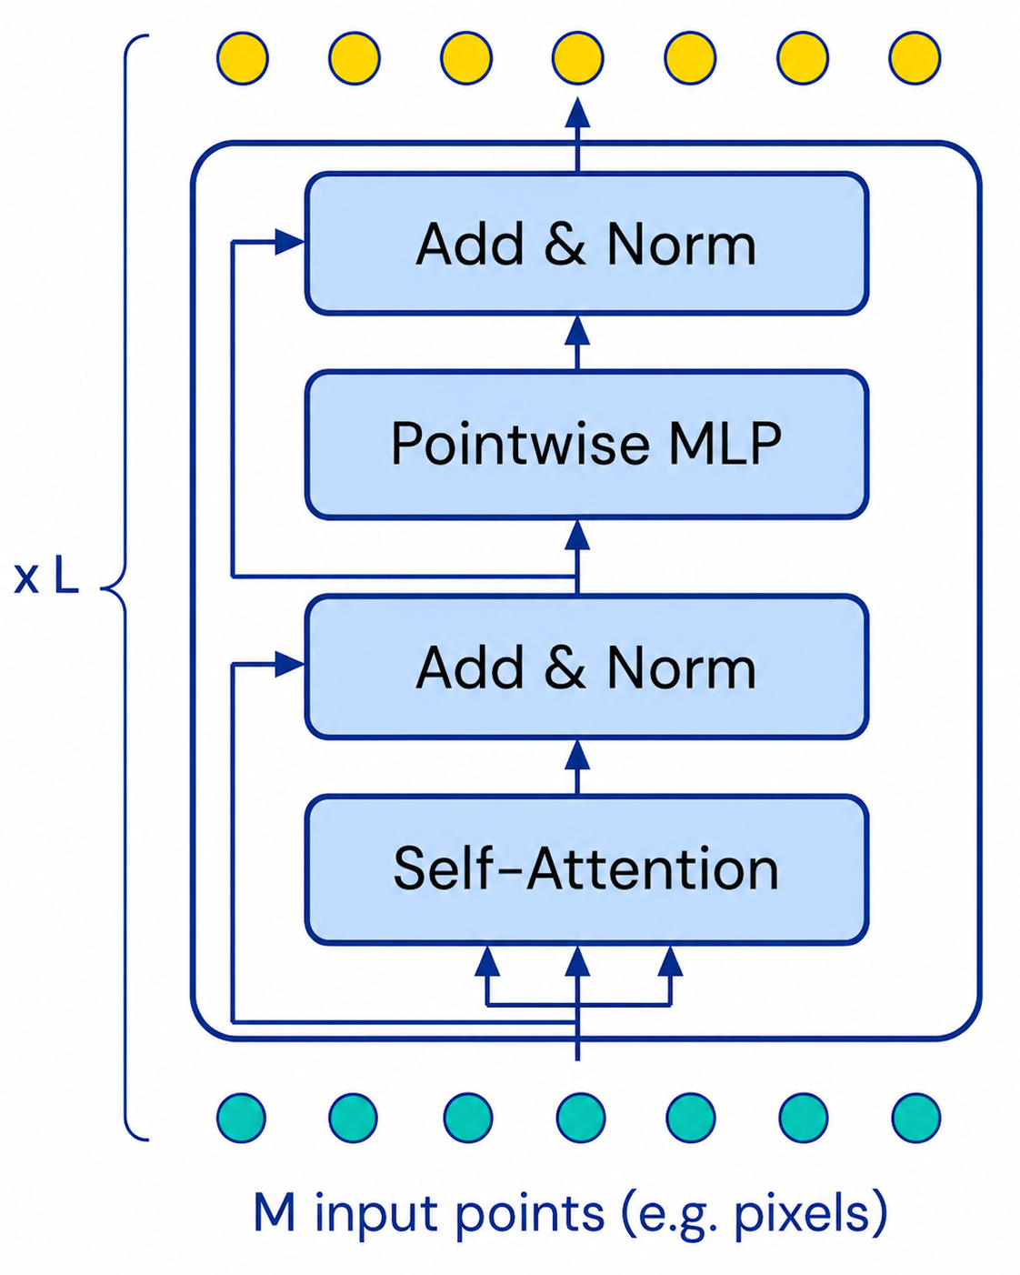
The Problem: Scaling bottleneck
A Transformer layer contains self-attention and a pointwise MLP.
Self-attention: compares all token pairs → cost $O$($M^{2}·L$)
Pointwise MLP: processes each token independently → scales linearly with $O\left(M·L\right)$
Input representation | M
16×16 image patches | 196
Raw 224×224 pixels | 50,176
!
The MLP scales linearly, but self-attention is the true bottleneck.
Raw pixels make standard attention impractical.
Can one architecture handle arbitrary inputs without quadratic cost?
F. Gigli C. Vignoli Perceiver & Perceiver IO

Slide 5
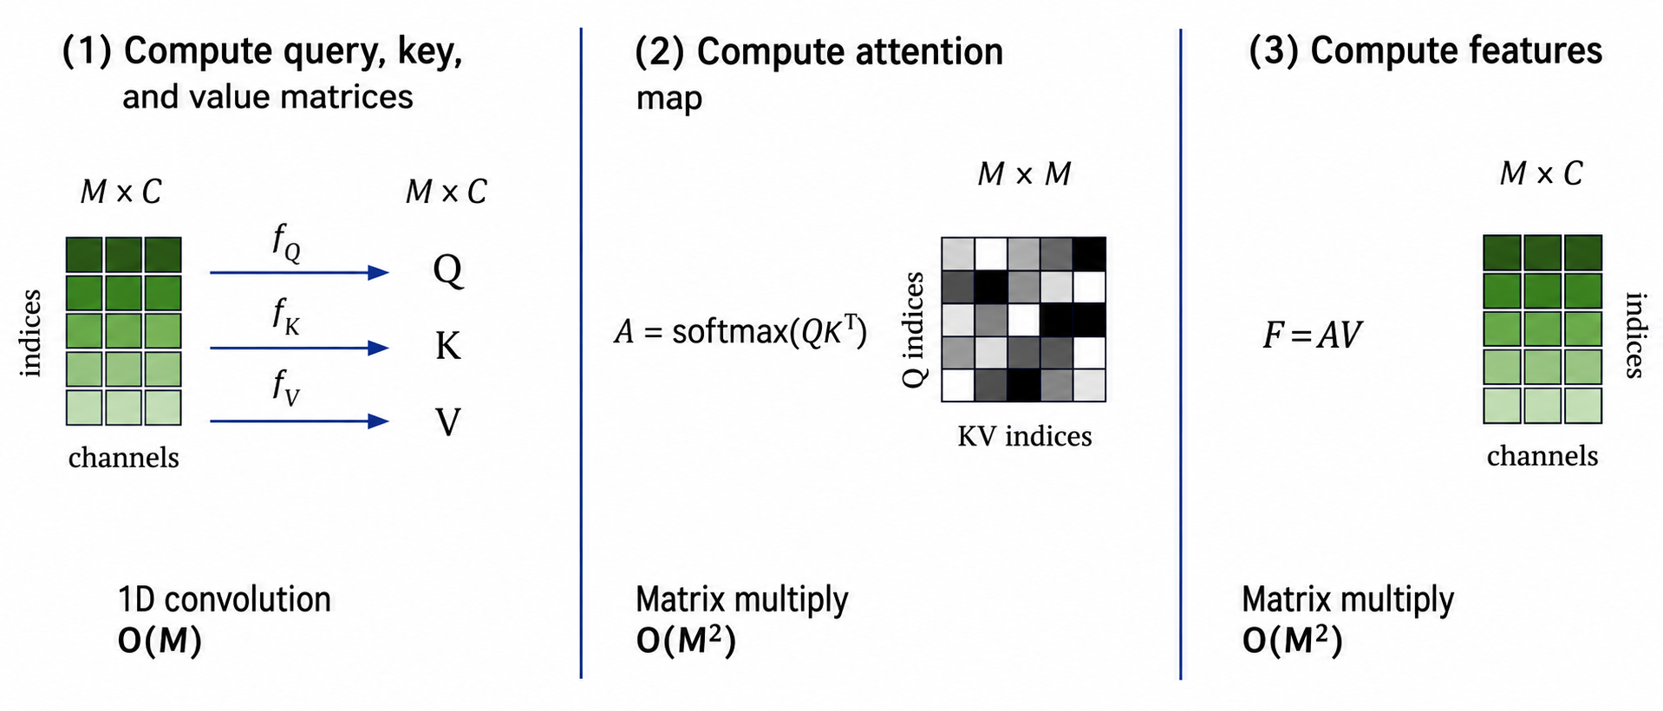
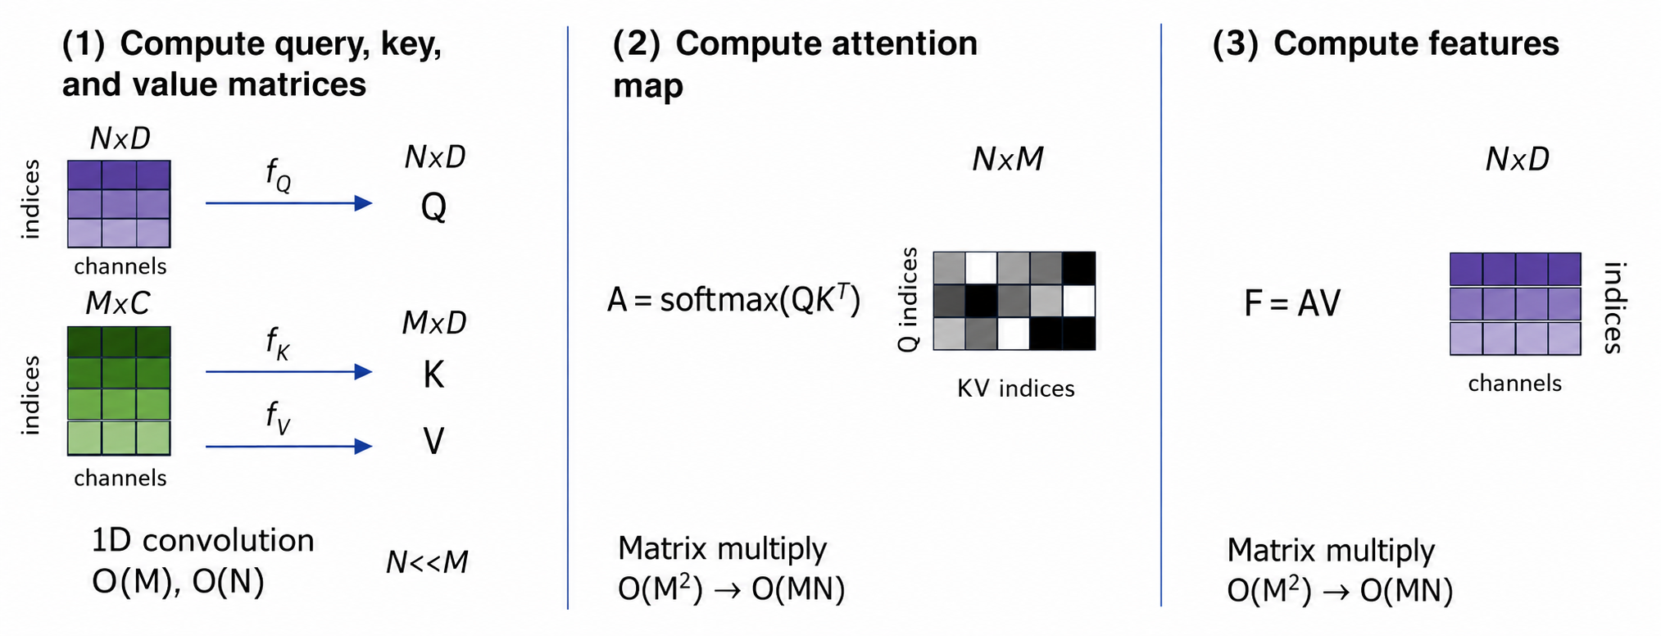
The Perceiver Solution
Standard self-attention
Perceiver cross-attention
O(M)
O(M²)
O(M²)
O(N) + O(M)
O(MN)
O(MN)
Self-attention: O(M²) → Cross-attention: O(MN)
F. Gigli C. Vignoli Perceiver & Perceiver IO

Slide 6
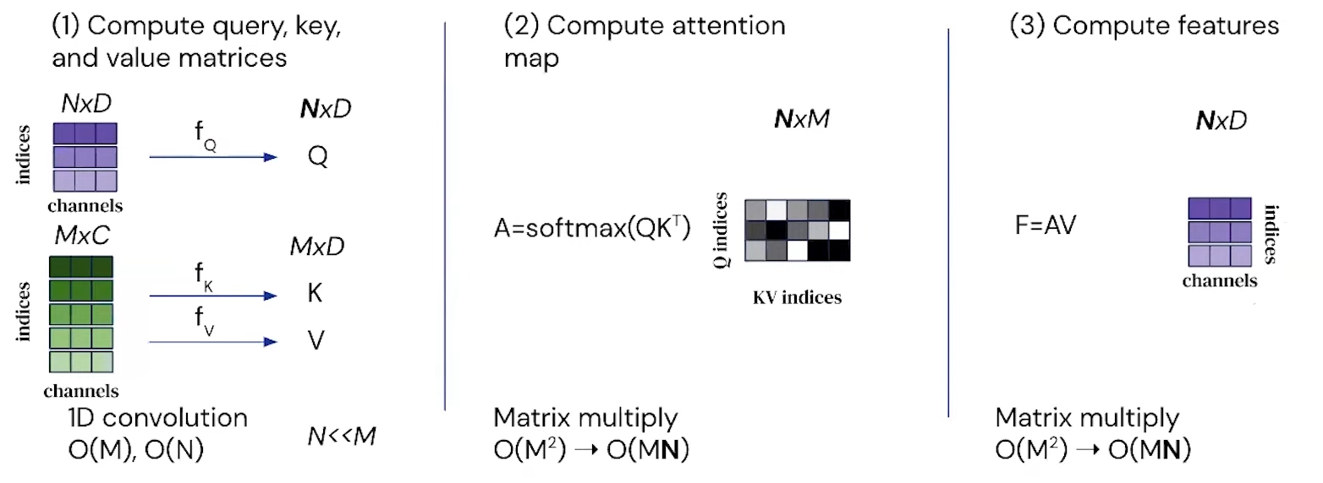
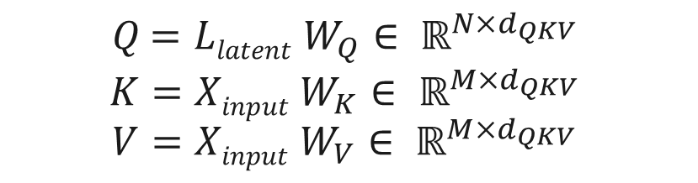
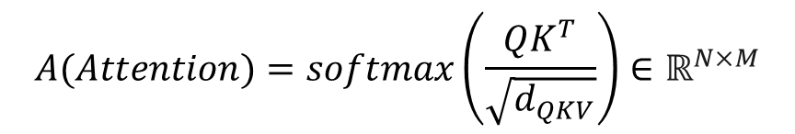

Cross-Attention
$Q$ $=Z W_{Q}∈ ℝ^{N×d_{k}}$
$$K=X W_{K}∈ ℝ^{M×d_{k}}$$
$$V=X W_{V}∈ ℝ^{M×d_{k}}$$
$$A(Attention)=softmax\left(\frac{QK^{T}}{\sqrt{d_{k}}}\right)∈ℝ^{N×M}$$
$F=CrossAttn(Q,K, V)$= $A∙V$ $∈$ $ℝ^{N×d_{k}}$
Cross-attention uses the latent array to read information from the input sequence.
The output (F) is a compact latent representation that will be refined by the latent transformer.
F. Gigli C. Vignoli Perceiver & Perceiver IO

Slide 7
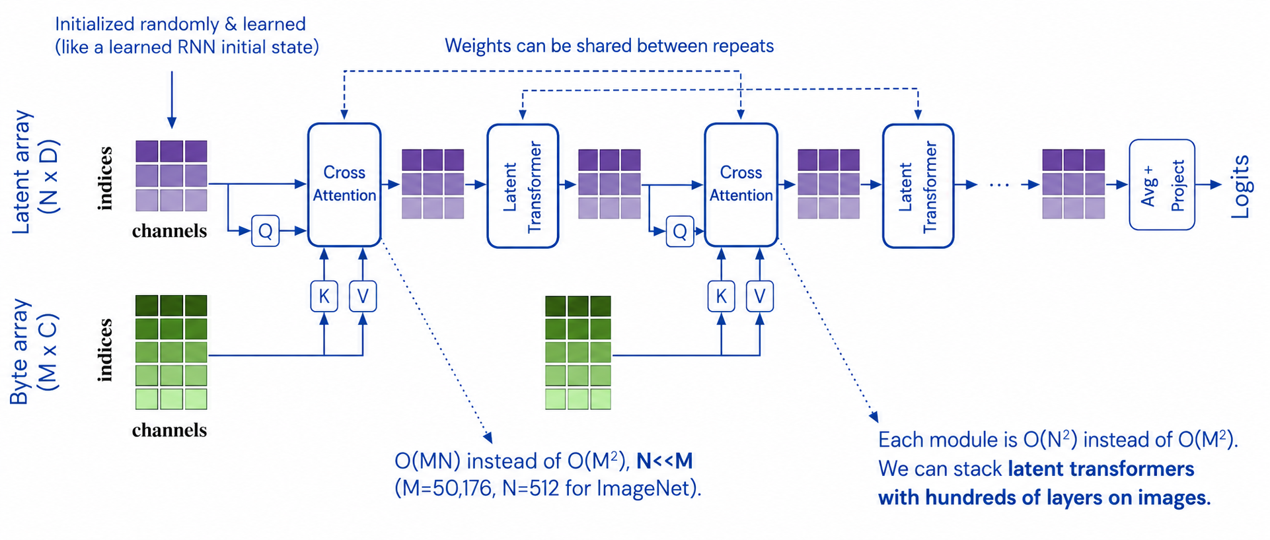
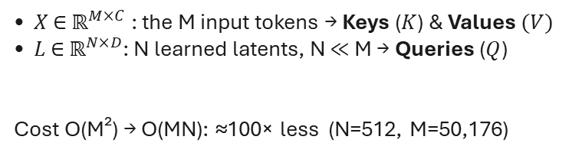
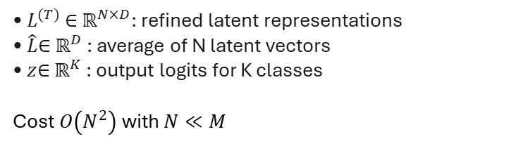
Perceiver Architecture
Encode and process
Latent core and output
• $X$ ∈ ${\text{ℝ}}^{M×C}$: the M input tokens → Keys ($K$) & Values $(V)$
• $L$ ∈ ${\text{ℝ}}^{N×D}$: N learned latents, N ≪ M → Queries ($Q$)
Cost O(M²) → O(MN): ≈100× less (N=512, M=50,176)
• $L^{(T)}$ ∈ ${\text{ℝ}}^{N×D}$: refined latent representations
• $\hat{L}$∈ ${\text{ℝ}}^{D}$: average of N latent vectors
• $z$∈ ${\text{ℝ}}^{K}$: output logits for K classes
Cost $O\left(N^{2}\right)$ with $N≪M$
F. Gigli C. Vignoli Perceiver & Perceiver IO

Slide 8
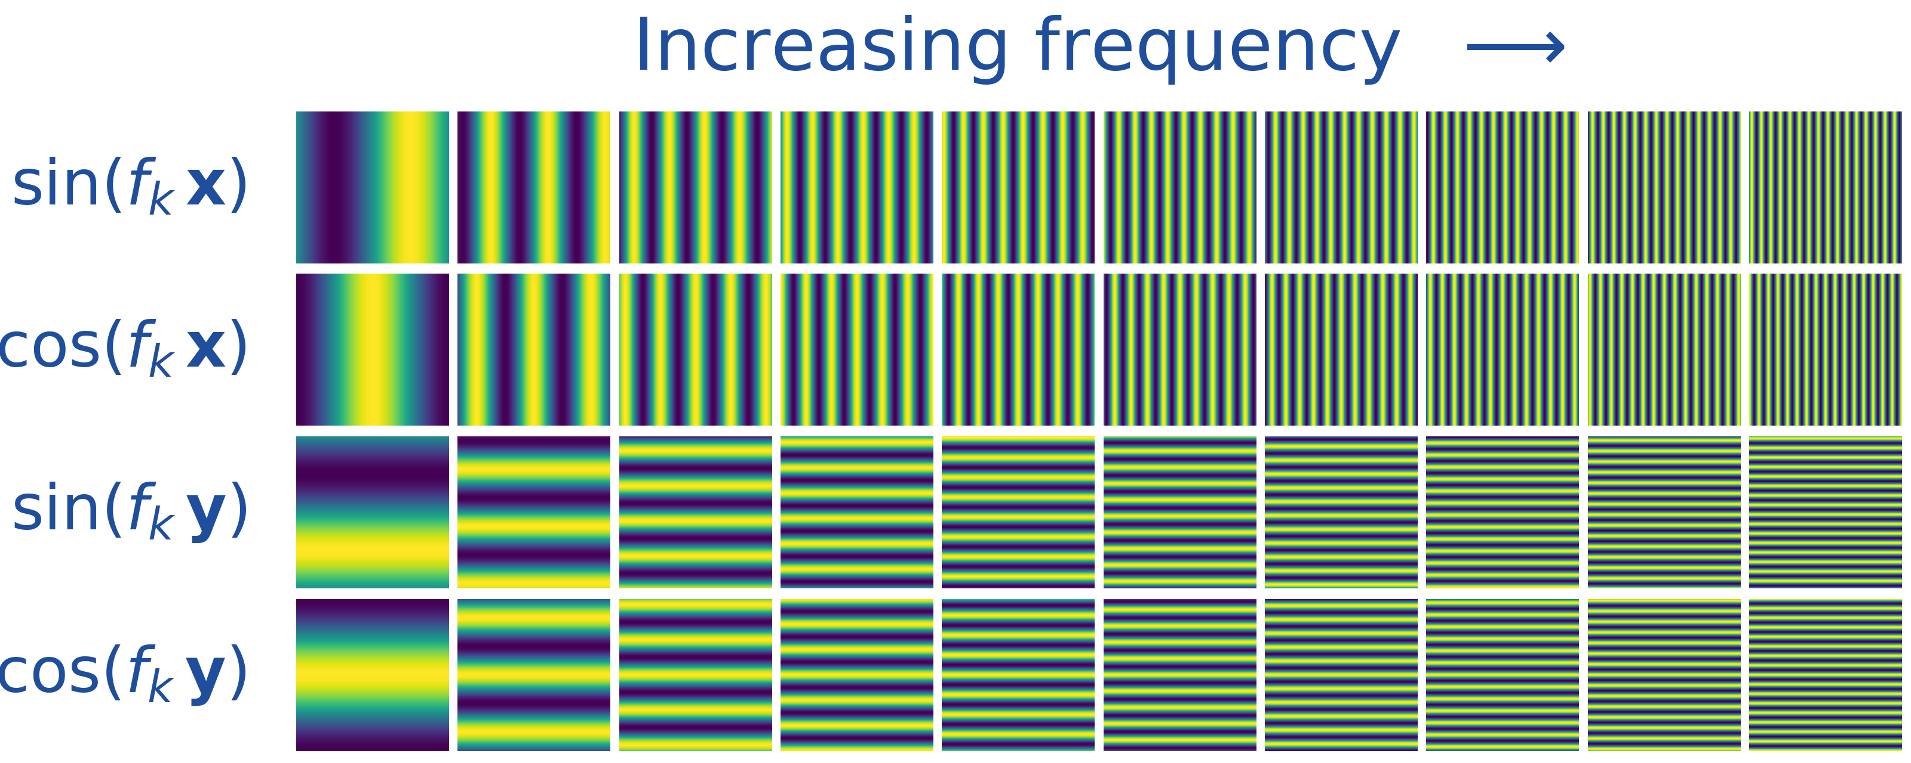
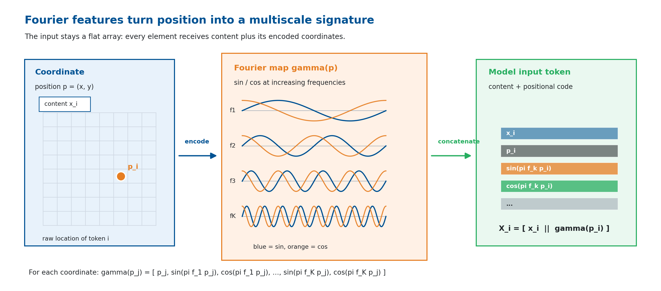
Fourier Positional Encoding
The Perceiver sees a flat array and attention is permutation-invariant, so position must be encoded into each input token.
$X_{i}=\left[x_{i}∥ γ\left(p_{i}\right)\right]$ — content ∥ Fourier position code
General recipe
Input seen by attention
• Domain coordinates: images (u, v), point clouds (x, y, z), text index t
• Sin/cos bands up to the Nyquist frequency — above it points alias and blur
• Sample the spectrum densely: more bands help (vs NeRF’s few)
• The array stays flat; each token is enriched before projection
• Position is concatenated to content, not added as in language
• Concatenation works better when content is dense (vision)
F. Gigli C. Vignoli Perceiver & Perceiver IO

Slide 9
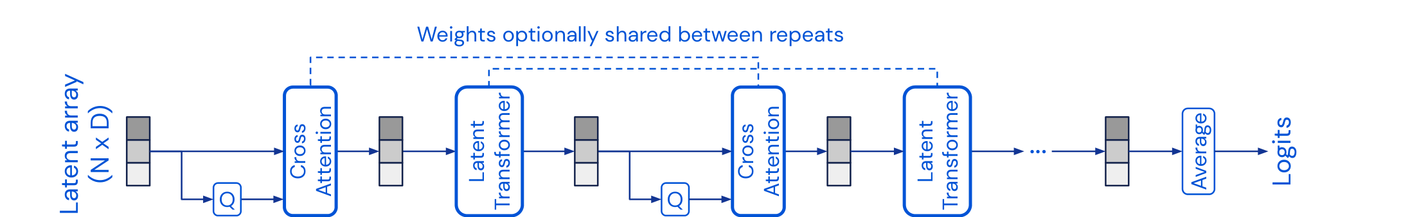
Latent Transformer & Weight Sharing
Once information is in the latent array, depth is spent by reusing the same processor on a compact state.
Weight sharing
Why it matters
• The same Latent Transformer block $B_{θ}$ is reused at every repeat, sharing parameters $θ$
• Unrolling depth behaves like an RNN over the latent state: $Z^{(t+1)}=B_{θ}(Z^{(t)})$
• Most useful in low-data regimes (e.g. ImageNet), where it curbs overfitting
• Iterative refinement without a new processor at each step
• Parameter count stays fixed as depth grows
• Computation stays in the compact N-slot latent space
• Optional repeated cross-attends re-read the input — powerful but heavy, no longer the default
F. Gigli C. Vignoli Perceiver & Perceiver IO

Slide 10
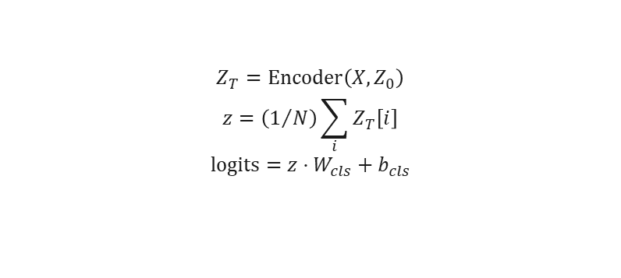
Original Perceiver Output: Pooling Classifier
The original Perceiver has exactly one way out: average the latents, then project. That fixes the output to a single label.
$$Z_{T}=\text{Encoder}\left(X,Z_{0}\right)$$
$$z=\left(1/N\right)\sum_{i}{Z_{T}\left[i\right]}$$
$$\text{logits}=z·W_{cls}+b_{cls}$$
What pooling does
Where the FFN and sharing sit
• The N latent vectors are averaged into one, so the output size no longer depends on the input
• That single vector is projected to the class logits
• It suits classification and nothing else: there is no way to ask for a mask or a sequence
• Each latent block is pre-norm attention, a residual, an FFN, then another residual
• The FFN adds the non-linearity once attention has mixed the slots
• Weight sharing reuses the same processor at every iteration; only the first cross-attention keeps its own weights
F. Gigli C. Vignoli Perceiver & Perceiver IO

Slide 11
Computational Complexity Analysis
A Transformer pays for every pair of input tokens. The Perceiver pays M·N per input read, then works on a fixed number of latents.
Model | Self-Attn | Cross-Attn | Total
Standard Transformer | $O(M^{2}d)$ | — | $O(M^{2}d·L)$
Perceiver | $O(N^{2}d)$ | $O(MNd)$ | $O((MN+N^{2}L)d)$
Symbols
What it buys
$M$ — number of input elements
$N$ — number of latent slots ($N≪M$)
$L$ — number of latent processing layers
$d$ — hidden channel dimension
• Only cross-attention reads the input: O(MN) per read
• Every latent block stays inside the N latent slots
• With N fixed, depth stops depending on how long the input is
• Only the reads grow with M; the latent blocks do not
F. Gigli C. Vignoli Perceiver & Perceiver IO

Slide 12
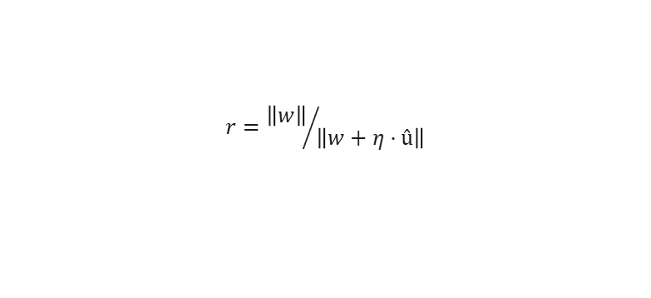
GELU Activation & LAMB Optimizer
Two choices inherited from the paper: a smooth activation, and an optimiser built for batches far larger than ours.
GELU — Gaussian Error Linear Unit
LAMB — Layer-wise Adaptive Moments
$$\text{GELU}\left(x\right)=x·Φ\left(x\right)≈x·σ\left(1.702x\right)$$
$$r={\left\|w\right\|}/{\left\|û+λw\right\|}$$
• A smooth activation, standard across Transformers
• It lets a small negative gradient keep flowing instead of clipping it to zero
• A per-layer trust ratio rescales each update
• It is what keeps very large batches from diverging
Why LAMB here, and what it cost us
• The paper found LAMB easier to optimise than SGD, the usual choice for CNNs on ImageNet; it does not test Adam
• Latent init scale 1.0 collapses our run to 52.08%; in the paper (LAMB too) it costs about 1 point: cause not isolated
F. Gigli C. Vignoli Perceiver & Perceiver IO

Slide 13
Implementation
The mechanism is the paper's; scale, budget and a few choices (MLP 4×) differ.
Aspect | Paper implementation | Project code
Core model | Cross-attention into learned latents, latent self-attention, FFN, weight sharing | Same modules; weight sharing exposed as an ablation switch
Model scale | Large runs: latents up to 2048×512 (IO flow), 201M-param IO | CIFAR-10 96×384; ModelNet40 / text 128×512
Data setting | ImageNet, ModelNet40, large language pretraining corpora | CIFAR-10, ModelNet40, WikiText-103 byte-MLM, GLUE fine-tuning
Training budget | Distributed accelerators, batches 512–8192 | Single-GPU, batches 32–64, LAMB retained
Practical additions | Minimal regularization in the reference setup | Validation split carved from train, fixed seed, attention-map extraction, declarative run registry
F. Gigli C. Vignoli Perceiver & Perceiver IO

Slide 14
Implementation Differences from the Paper
Most differences from the paper follow from one GPU instead of a TPU pod. The mechanism itself is untouched.
Choice | Original paper | This project
Input tokenization | Raw pixels, no patching (M = 50,176) | Raw pixels, no patching (CIFAR-10, M = 1,024)
Latent array N × D | 512 × 1024 | 96 × 384 (CIFAR-10); 128 × 512 (ModelNet40, text)
Cross-attend iterations T | 8 | 4 (CIFAR-10); 2 (ModelNet40); 1 (text)
Positional encoding | Fourier, K = 64 bands/axis (ImageNet: 258 dims; ModelNet40 too) | CIFAR-10 identical (258 dims); ModelNet40 and text: K = 6 (42 per point, 270 per byte)
Weight sharing | On by default (shared across T) | Exposed as an ablation switch (on/off)
Parameters, MLP width | 44.9M (ImageNet); MLP 1× (hidden = D) | 10.2M (CIFAR-10) · 23.3M (ModelNet40) · 18.9M (IO text); MLP 4×
Not from the budget: MLP 4× (paper 1×); ModelNet40 scale and shift undone by normalisation (the paper jitters each point); single-byte masking, the paper whole words.
F. Gigli C. Vignoli Perceiver & Perceiver IO

Slide 15
CIFAR-10: Experimental Setup
Goal — validate the Perceiver on raw pixels: one token per pixel, no patching, no convolutional assumptions.
Hyperparameter | Value
Latent array (N × D) | 96 × 384
Cross-attn stages (T) | 4, interleaved, shared
Transformer blocks (L) | 4 (shared)
Attention heads | 1 cross · 8 self
Input tokens (M) | 1,024 raw pixels
Dropout | 0.0
Optimizer / LR | LAMB · 0.004
LR schedule | MultiStep [84, 102, 114]
Batch size | 64
Epochs | 120 (no early stopping)
Total parameters | 10.18M
What we varied
• Positional encoding: Fourier, learned, or none at all
• How many cross-attends, and where they sit
• Weight sharing and the latent transformer
• Fourier bands, maximum frequency, latent init scale
• And three identical runs, to measure the noise
How the data reaches the model
• A 32×32 image becomes 1,024 tokens, one per pixel
• The Fourier encoding adds 258 features: each token carries 261 numbers
• Augmentation is RandAugment alone, two ops at magnitude 9
• 5,000 training images are held out as the validation split
F. Gigli C. Vignoli Perceiver & Perceiver IO

Slide 16
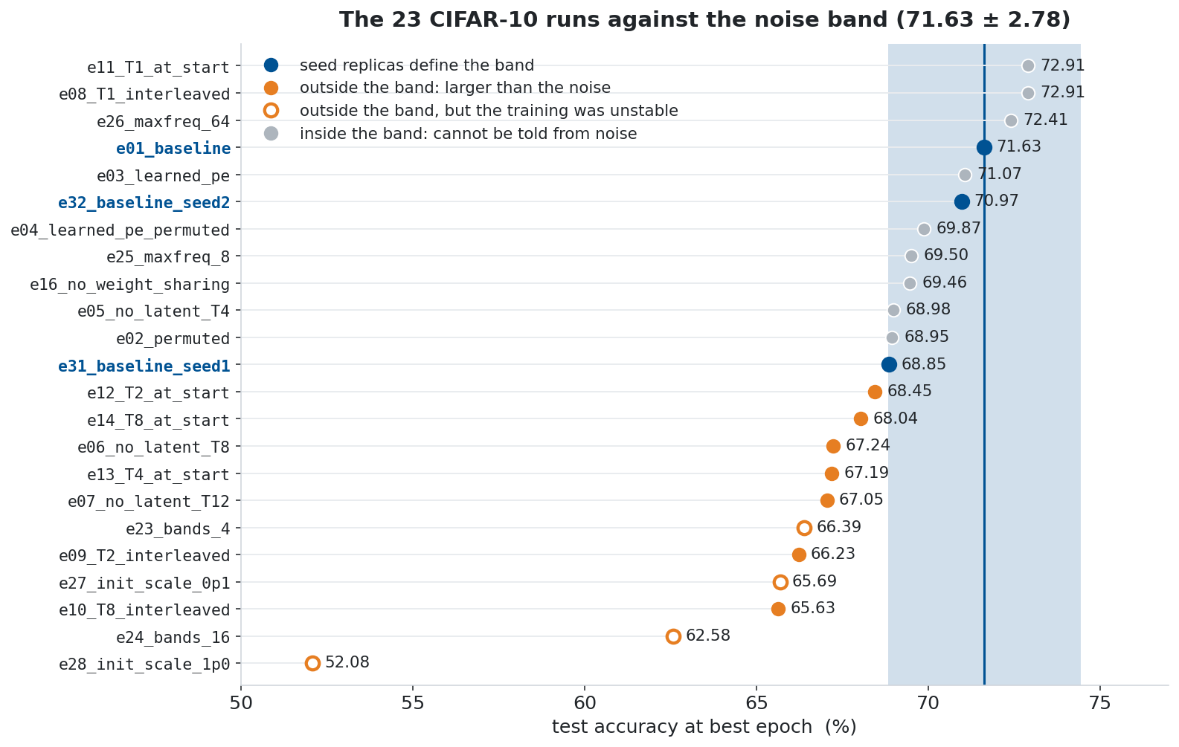
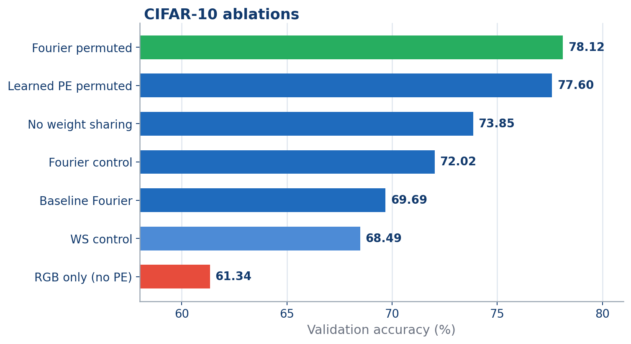
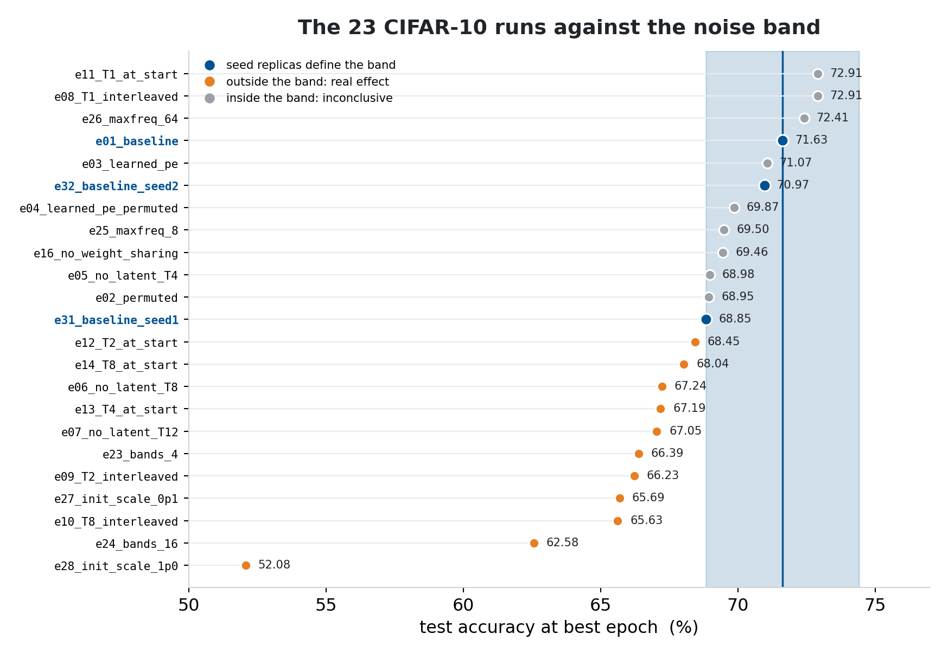
CIFAR-10: Ablation Accuracy
Twenty-four runs on CIFAR-10. The best reaches 72.91%, the baseline 71.63% — a 1.28-point gap, inside the noise.
What moved the number
• Removing the positional encoding: −39.27 points
• Latent init scale at 1.0: −19.55, an unstable run
• Sixteen bands: −9.05, a collapsed run
What did not
• One cross-attend instead of four gains 1.28 points, inside the 2.78-point band, with 4 latent blocks instead of 16: in our code depth grows with T
• Every figure comes from logs/<run>/results.json, at the epoch chosen on validation
F. Gigli C. Vignoli Perceiver & Perceiver IO

Slide 17
CIFAR-10: Ablation Matrix
Ranked by accuracy, with the verdict computed against the noise band — not decided by eye.
Run | Change | Params | Acc. | vs e01 | Verdict
e08_T1_interleaved | T = 1 | 8.65M | 72.91% | +1.28 | inside band
e26_maxfreq_64 | f_max 64 | 10.18M | 72.41% | +0.78 | inside band
e01_baseline | — reference | 10.18M | 71.63% | — | —
e16_no_weight_sharing | no sharing | 31.46M | 69.46% | -2.17 | inside band
e02_permuted | permuted | 10.18M | 68.95% | -2.68 | inside band
e24_bands_16 | 16 bands | 9.63M | 62.58% | -9.05 | collapsed
e28_init_scale_1p0 | init scale 1.0 | 10.18M | 52.08% | -19.55 | collapsed
e29_no_pe | no PE | 9.51M | 32.36% | -39.27 | real effect
Position is everything
• Removing the encoding costs 39.27 points, the largest effect measured by a wide margin
Capacity is not the limit
• Tripling the parameters to 31.46M loses 2.17 points, inside the band
Order carries nothing
• A fixed permutation costs 2.68 points, also inside the band
F. Gigli C. Vignoli Perceiver & Perceiver IO

Slide 18
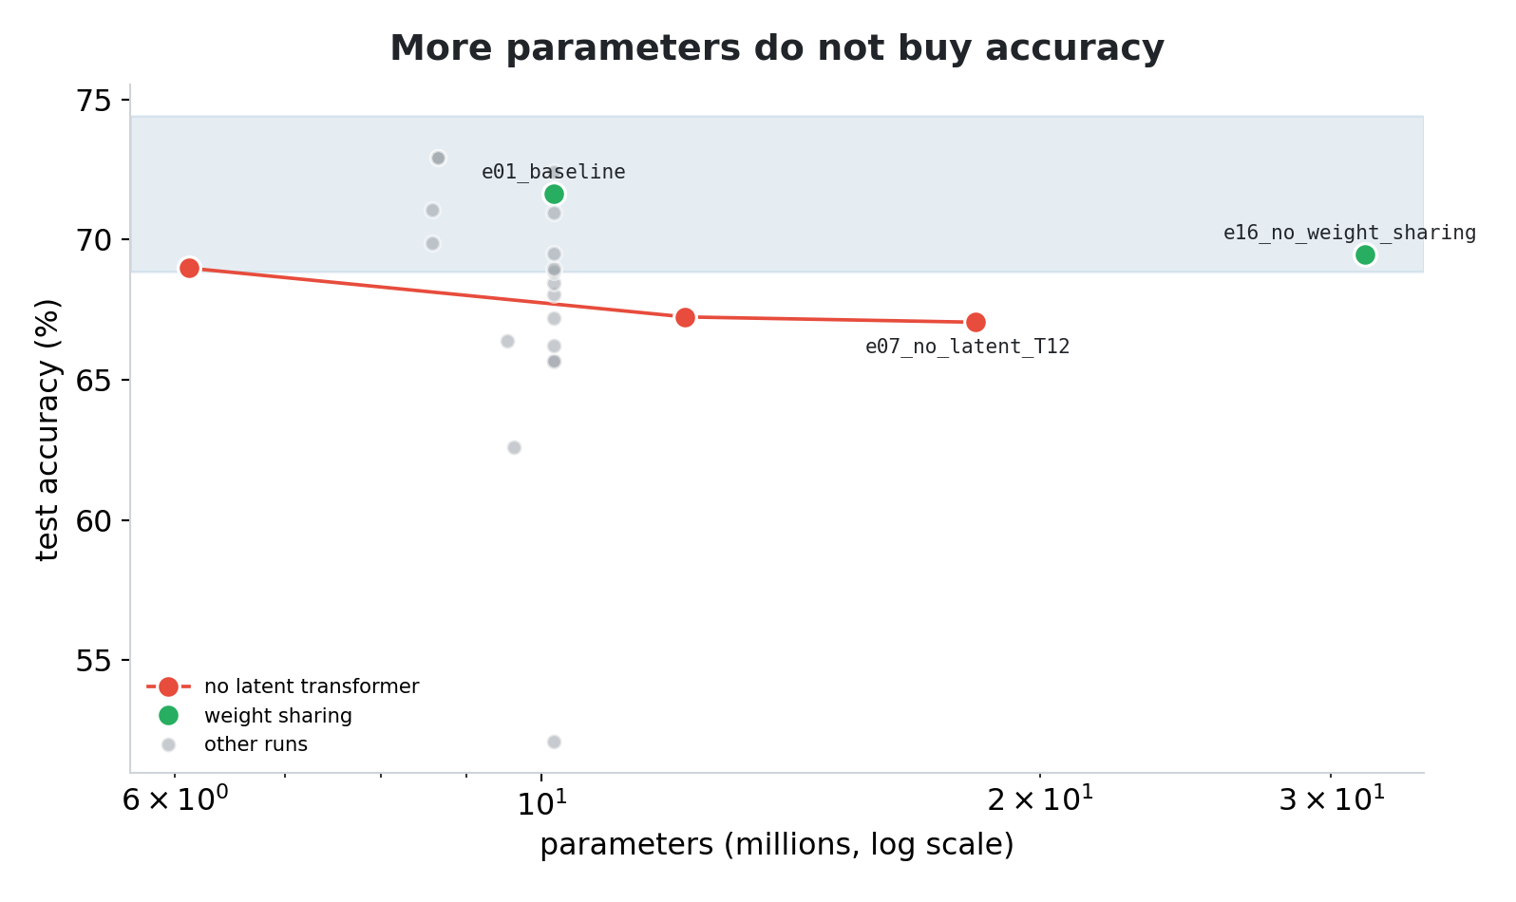
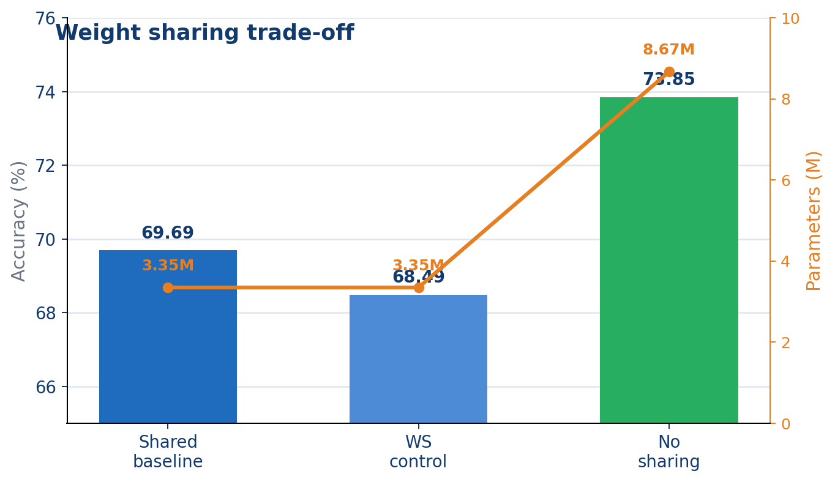
CIFAR-10: Weight Sharing Trade-off
Dropping weight sharing triples the parameter count and buys nothing measurable.
The trade-off, in numbers
What it means
• Shared, the baseline: 10.18M parameters, 71.63%
• Not shared: 31.46M parameters, 69.46% — 2.17 points lower
• Without the latent transformer at T=12: 18.29M, 67.05%
• Three times the parameters do not buy a point, and the difference sits inside the 2.78-point noise band
• Capacity is not what limits this model at CIFAR-10 scale
• Sharing saves weights, yet e16 also ran on the same GPU at batch 64
F. Gigli C. Vignoli Perceiver & Perceiver IO

Slide 19
CIFAR-10: Fixed-Permutation Test
Train and evaluate on pixels shuffled by one fixed permutation σ — the same σ throughout.
Configuration | Acc.
Fourier PE, natural order (e01) | 71.63%
Fourier PE, permuted (e02) | 68.95%
Learned PE, natural order (e03) | 71.07%
Learned PE, permuted (e04) | 69.87%
What we measured
• Shuffling costs 2.68 points with Fourier features, 1.20 with a learned table
• Both sit inside the 2.78-point band, so neither is a measurable loss
The control that turns it into a claim
• Remove the encoding instead and accuracy collapses to 32.36%: a loss of 39.27 points
• So position does reach the model — through the encoding, never through the grid
• The learned-PE runs use one cross-attend, as in the paper: with 8 it was unstable
F. Gigli C. Vignoli Perceiver & Perceiver IO

Slide 20
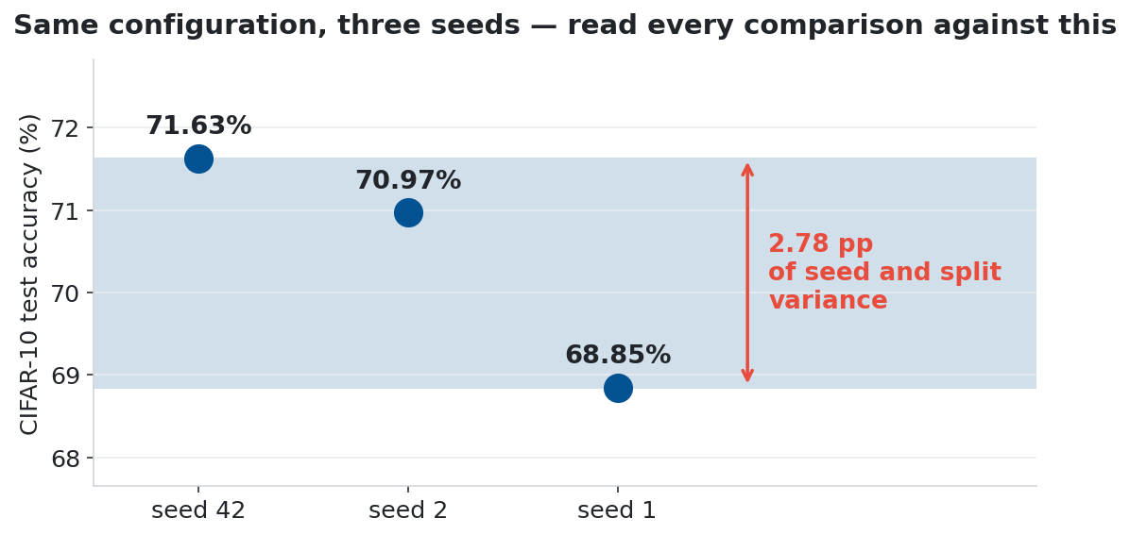
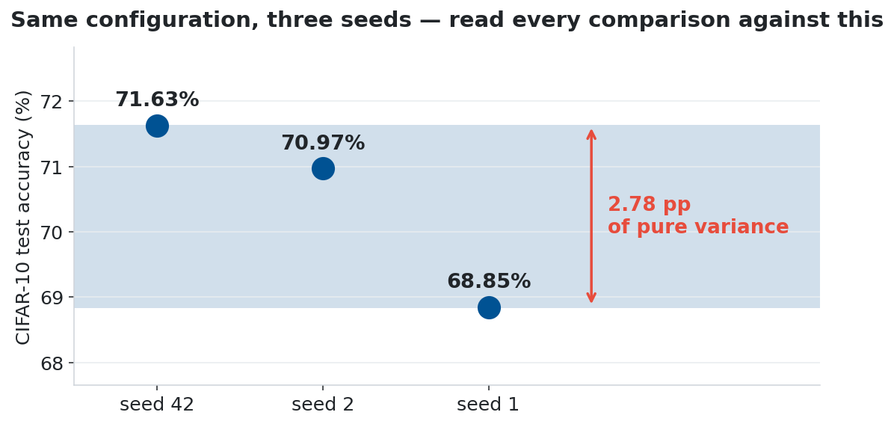
The Noise Band: What a Number Does on Its Own
Three runs that differ in seed and validation split land 2.78 points apart. Read every other comparison against that.
The three runs
The rule this sets
• Seed 42 gives 71.63%, seed 2 gives 70.97%, seed 1 gives 68.85%: the reference is the luckiest of the three
• The seed also moves the validation split; test set unchanged
• A gap below 2.78 points cannot be told apart from variance
• Twelve of the 21 CIFAR-10 ablations clear the band, ten measured from the three-seed mean (70.48%); the rest are reported as inconclusive
• It cost two runs and changed the status of the CIFAR-10 runs
F. Gigli C. Vignoli Perceiver & Perceiver IO

Slide 21
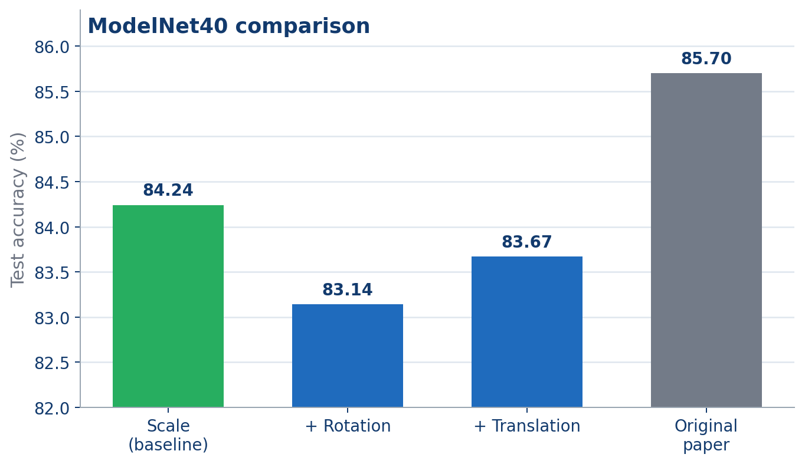
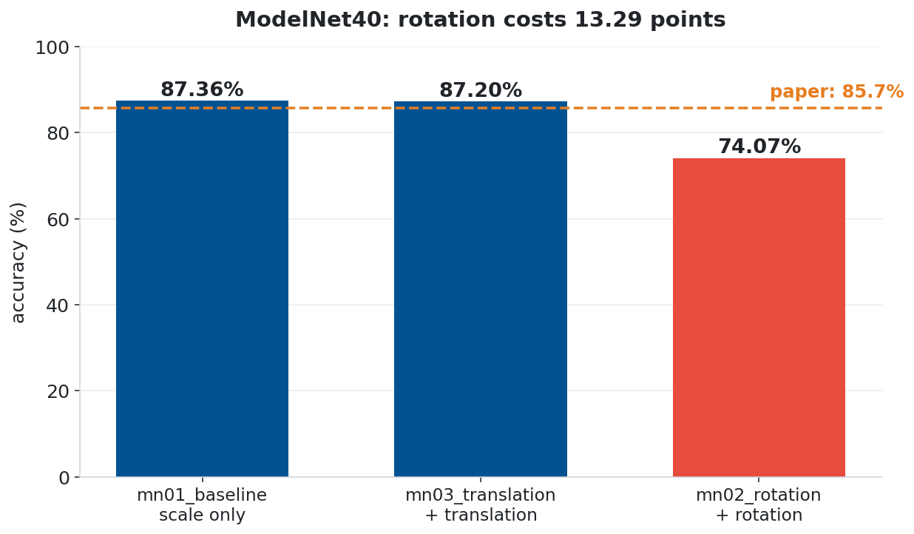
ModelNet40: Setup & Results
The same architecture, fed 2,048 points in 3D instead of pixels, with its own configuration (table).
Hyperparameter | Value
Latent array (N × D) | 128 × 512
Cross-attn stages (T) | 2
Transformer blocks (L) | 6 (shared)
Points per object | 2,048
Optimizer / LR | LAMB · 0.001
Epochs | 120
Batch size | 32
Total parameters | 23.29M
What changed, and what did not
• The encoder is untouched: cross-attention into latents, a shared latent transformer, mean pooling
• The Fourier encoding becomes 3D over (x, y, z), with 6 bands per axis (the paper uses 64)
• Nothing in the architecture knows it is looking at geometry
The result
• 87.36% against the paper's 85.7%, epoch picked on test as in the paper; 86.43% at the last epoch
• Different configuration (6 bands, batch 32, stepped lr) and no noise band: the point is generality
F. Gigli C. Vignoli Perceiver & Perceiver IO

Slide 22
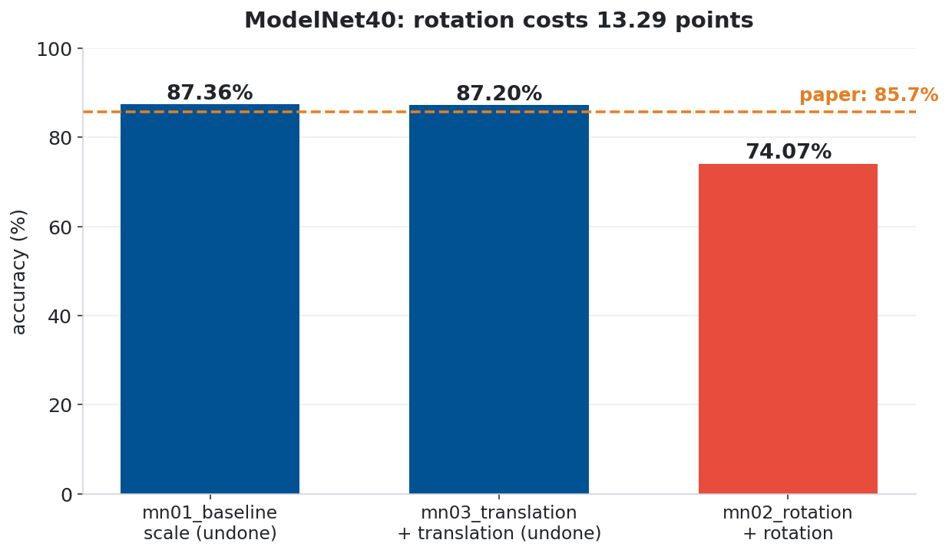
ModelNet40: Augmentation Effects
Rotation costs 13.29 points — the positional encoding again. Scale and translation never reach the network.
The three runs
Why rotation is different
• Scale only: 87.36%
• Plus translation: 87.20%, the same data as the first run: 0.16 is noise
• Plus rotation: 74.07%, a loss of 13.29
• ModelNet40 objects are probably stored upright (not verified)
• Random rotation destroys that alignment, and the 3D Fourier encoding of the coordinates with it
• Scale and translation move the whole cloud, and the re-centring undoes them; the paper jitters each point
F. Gigli C. Vignoli Perceiver & Perceiver IO

Slide 23
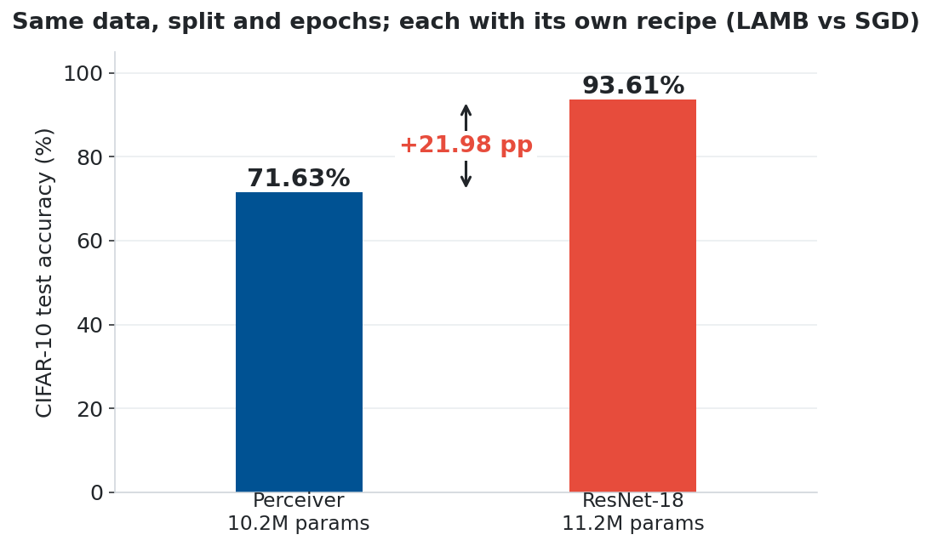
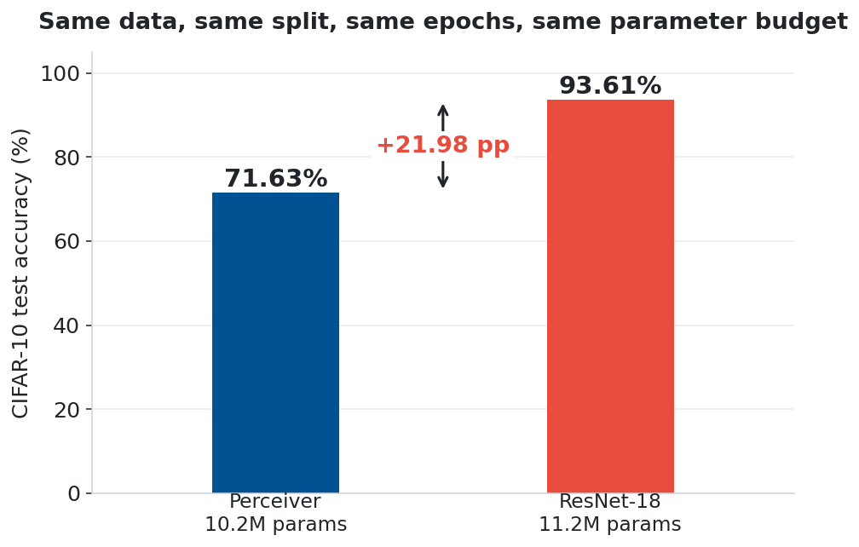
CIFAR-10: The Reference That Is Not a Perceiver
Neither Perceiver paper benchmarks CIFAR-10, so we trained the reference ourselves: a ResNet-18, same split and epochs, own SGD recipe.
The comparison
What the gap measures
• The ResNet-18 reaches 93.61%; the Perceiver baseline reaches 71.63%
• That is 21.98 points, with 11.2M parameters against 10.2M
• On ImageNet the paper edges ResNet-50 by 0.4 (4.5 over ResNet-50 with Fourier features)
• It claimed generality at comparable accuracy
• Here prior plus recipe cost 22 points; at ImageNet scale the prior stops paying
F. Gigli C. Vignoli Perceiver & Perceiver IO

Slide 24
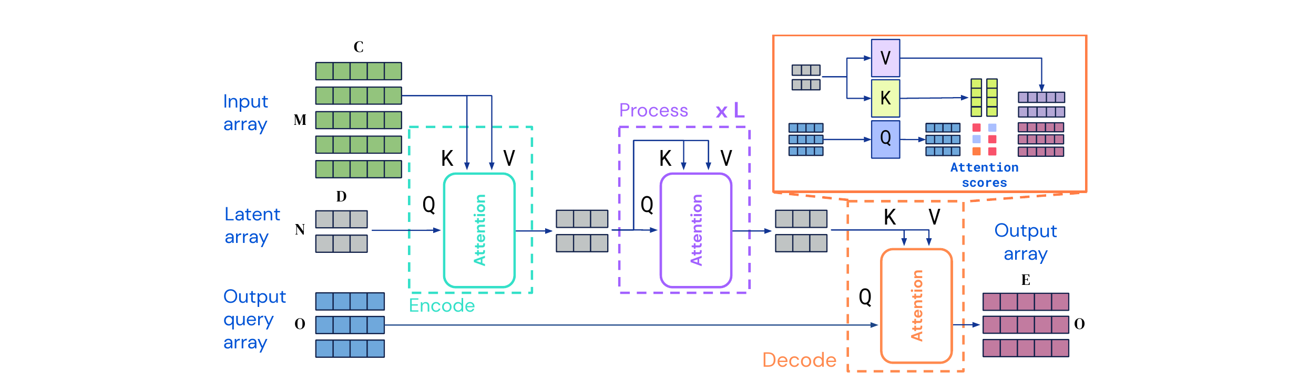
Perceiver IO: Structured Outputs
Perceiver IO keeps the same latent bottleneck and replaces the exit: instead of pooling, you ask the latents a question.
What changes
What stays
• The original Perceiver emits one pooled vector, so one global label
• Perceiver IO emits whatever shape the query array has
• The output size stops being an architectural constraint
• The encoder is the same: cross-attention into N latents, then a shared latent transformer
• The decoder costs one cross-attention layer, nothing more
F. Gigli C. Vignoli Perceiver & Perceiver IO

Slide 25
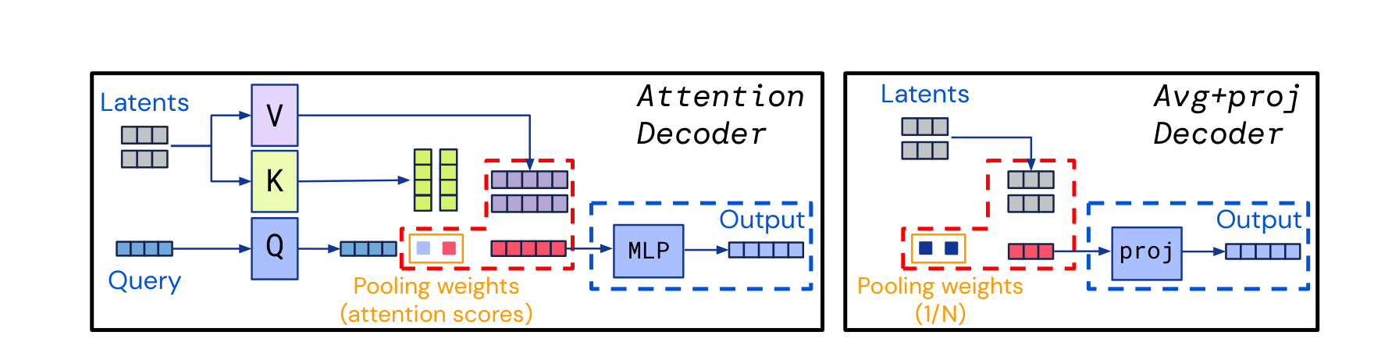
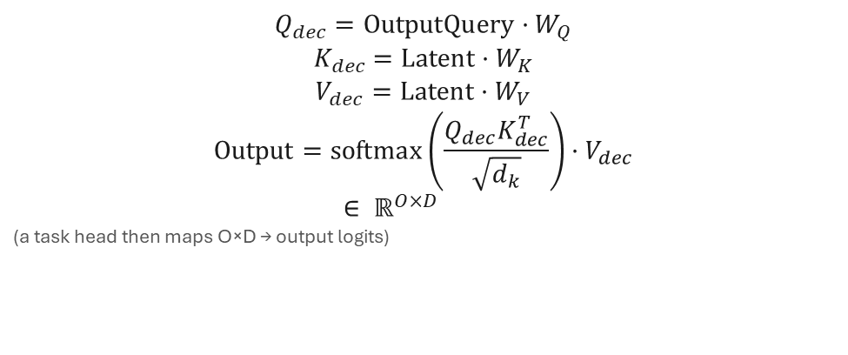
Perceiver IO Decoder with Output Queries
The decoder is one cross-attention layer: the queries come from the task, the keys and values from the latents.
$$Q_{dec}=\text{OutputQuery}·W_{Q}$$
$$K_{dec}=\text{Latent}·W_{K}$$
$$V_{dec}=\text{Latent}·W_{V}$$
$$\text{Output}=\text{softmax}\left(\frac{Q_{dec}K_{dec}^{T}}{\sqrt{d_{k}}}\right)·V_{dec}$$
$$∈ ℝ^{O×D}$$
(a task head then maps $O×D$ → output logits)
How it works
Why that matters
• The number of output queries O depends only on the task — not on N, not on M
• One cross-attention layer is enough, and there is no self-attention among the outputs
• The output shape becomes a design choice instead of an architectural constraint
• Adding a task means adding queries, not building another model
F. Gigli C. Vignoli Perceiver & Perceiver IO

Slide 26
Output Query Design per Task
All heads read the same final latent array $Z^{(L)}∈{\text{ℝ}}^{N×D}$ via decoder cross-attention.
Classification
Dense outputs
Masked LM
$O=1$​
$O=H×W$​
$O=M$​
→ class logits
→ dense output
→ token logits
One learned query produces a single global prediction.
The output shape is controlled directly by the query array.
One query per byte position; the loss is scored only where the input was masked.
F. Gigli C. Vignoli Perceiver & Perceiver IO

Slide 27
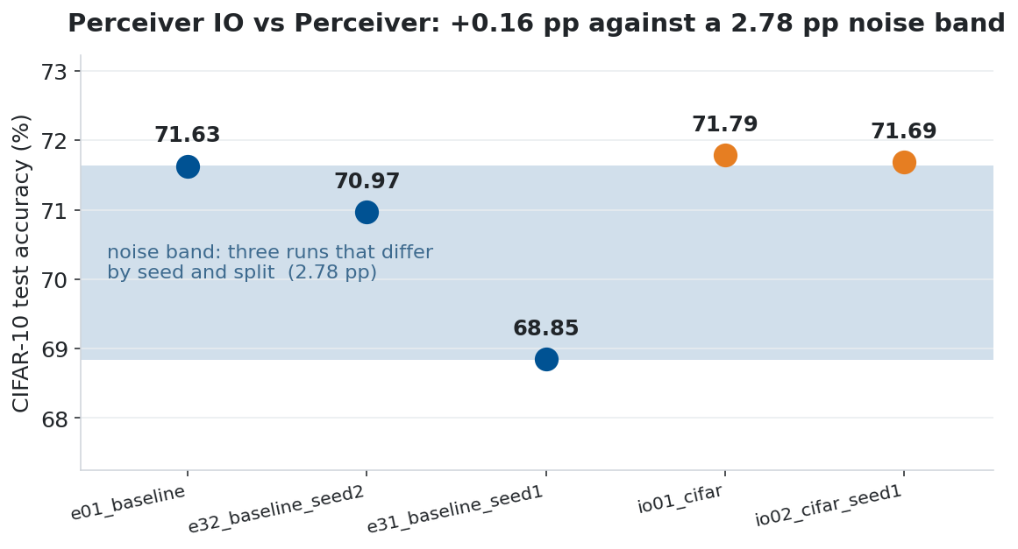
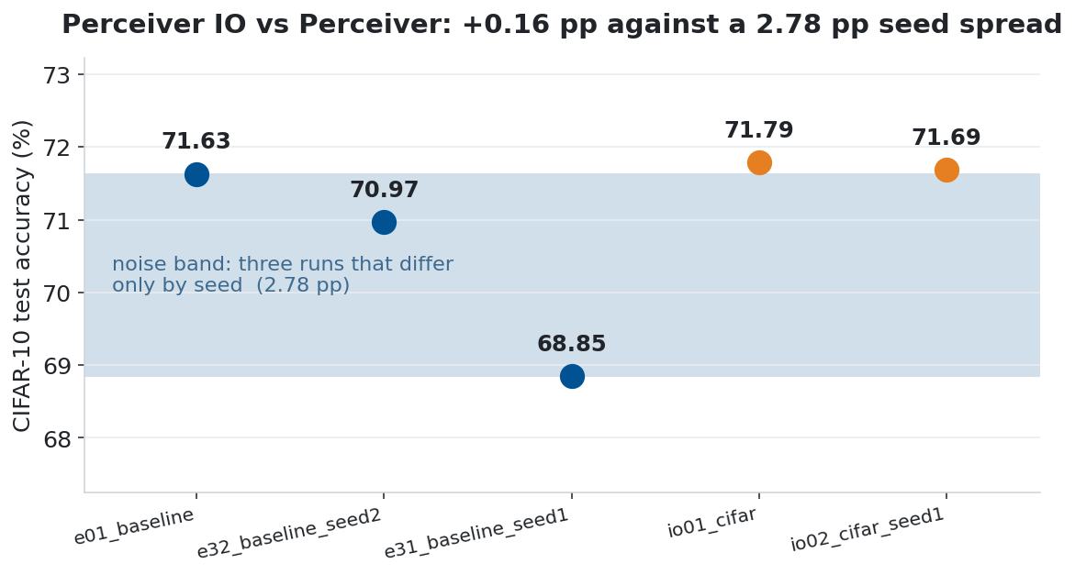
CIFAR-10: Perceiver vs Perceiver IO
On a single label out of ten, our 2.78-point band cannot separate the query decoder from mean pooling.
What the decoder does differently
What it is worth here
• The output query is a learned aggregation instead of a fixed average
• It cross-attends to the latents, so it can weight them unequally
• 71.79% vs 71.63% (+0.16, in band), but the recipe changed too: cosine at 1e-3
• And it costs 12.05M parameters against 10.18M
• The decoder earns its place on the MLM and on dense outputs, not on this task
F. Gigli C. Vignoli Perceiver & Perceiver IO

Slide 28
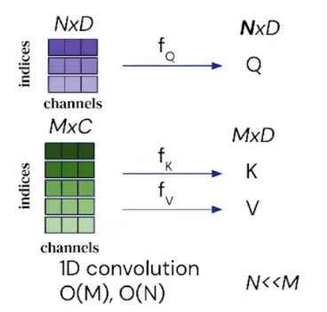
WikiText-103: Masked Language Model Pre-training
Pre-train a language encoder with no tokenizer at all: the input is the raw UTF-8 byte stream.
Component | Detail
Tokenization | Byte-level UTF-8, no tokenizer
Vocabulary size | 256
Sequence length | 512
Masking | 15% of single bytes (paper: words)
Latent array (N × D) | 128 × 512
Model | Perceiver IO, 18.87M params
Epochs / batch | 10 / 32
Masked-byte accuracy | 86.68%
Lookup of the two neighbours | 42.96% (no network)
Why bytes
• No BPE or WordPiece vocabulary to build, and nothing language-specific in the input
• The vocabulary is fixed at 256 — every byte value there is
• The price is length: the same text takes about four times more tokens
The task, and the result
• 15% of the byte positions are masked, with one output query per position
• The decoder predicts the original byte, one of 256
• 86.68% correct: 44 points above a lookup of the two neighbouring bytes, 68 above always answering a space
F. Gigli C. Vignoli Perceiver & Perceiver IO

Slide 29
GLUE: Fine-tuning on 8 Tasks
The same encoder, the same weights, one query swapped. Eight tasks, eight fine-tunings.
How the fine-tuning runs
The eight tasks
• The encoder is loaded from the MLM checkpoint; if it is missing the code stops instead of pretending
• The query array is replaced by a single classification query
• LAMB at 5 × 10⁻⁴ with a cosine schedule
• The epoch budget follows task size: 3 epochs for 393k examples, 30 for 2.5k
• The input stays byte-level at sequence 512, identical to pre-training
• Single sentence — CoLA judges grammatical acceptability, SST-2 sentiment
• Similarity — MRPC and QQP ask whether two sentences mean the same, STS-B by how much
• Inference — MNLI, QNLI and RTE ask whether one sentence follows from another
• Each probes a different ability, and the architecture never changes
F. Gigli C. Vignoli Perceiver & Perceiver IO

Slide 30
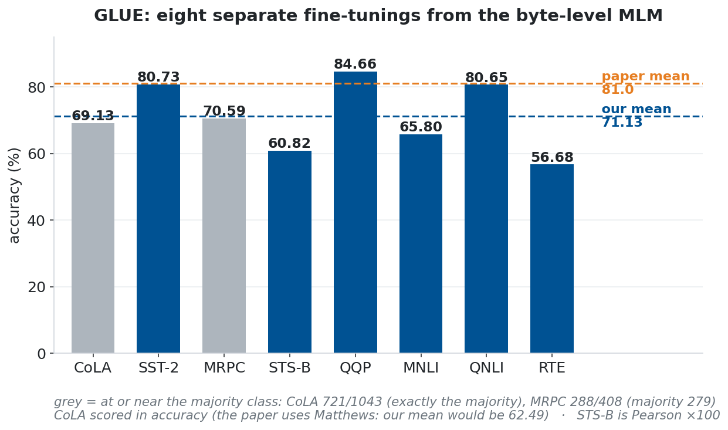
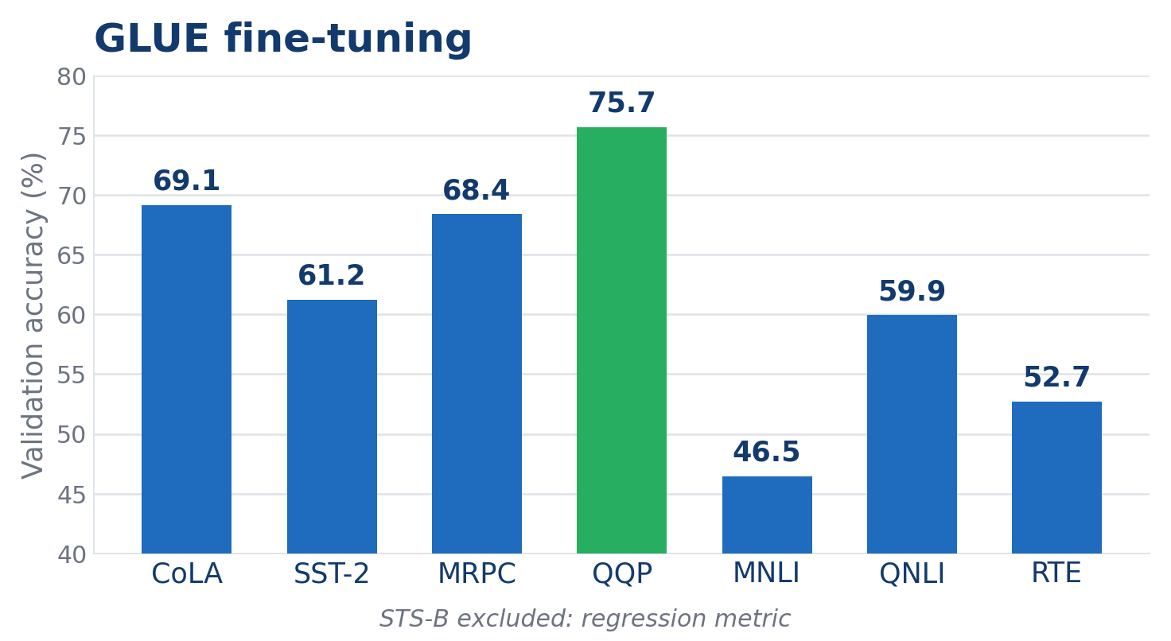
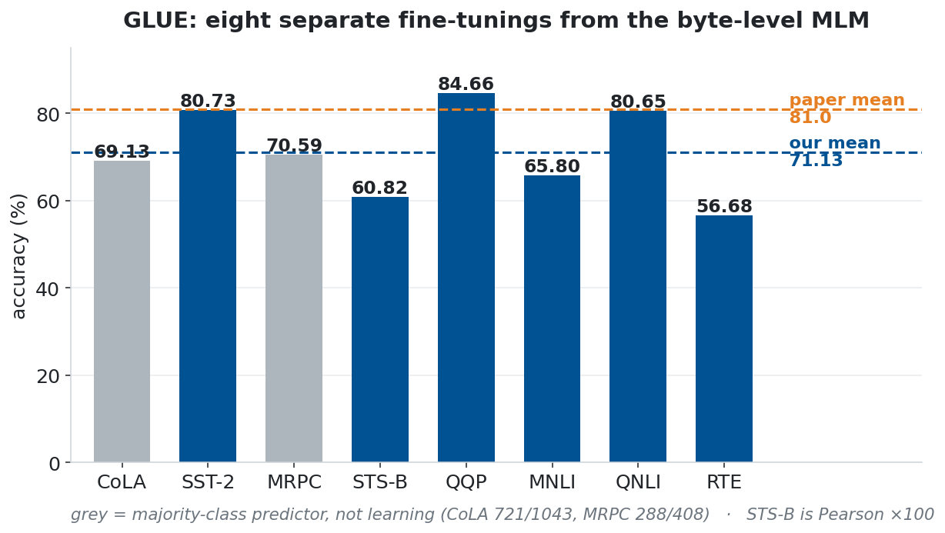
GLUE: Per-Task Results
The mean is 71.13 against the paper's 81.0; with CoLA in Matthews, as in the paper, it is 62.49.
What the runs say
Why the level sits below the paper
• QQP is the strongest at 84.66%, RTE the weakest at 56.68%
• CoLA scores exactly the majority-class count, 721 of 1,043; MRPC beats its majority by nine examples out of 408
• So the mean rests on six tasks, not eight
• 18.9M parameters pre-trained on WikiText-103, against 201M on Wikipedia and C4
• Byte-level input, with no subword tokenizer to lean on
• STS-B is reported as Pearson × 100, as in the paper
F. Gigli C. Vignoli Perceiver & Perceiver IO

Slide 31
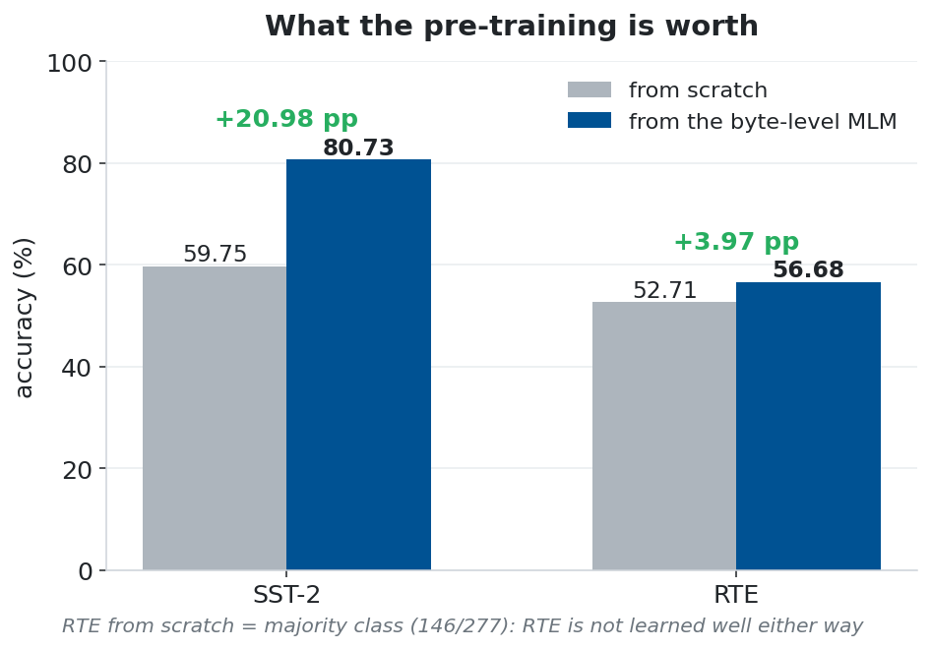
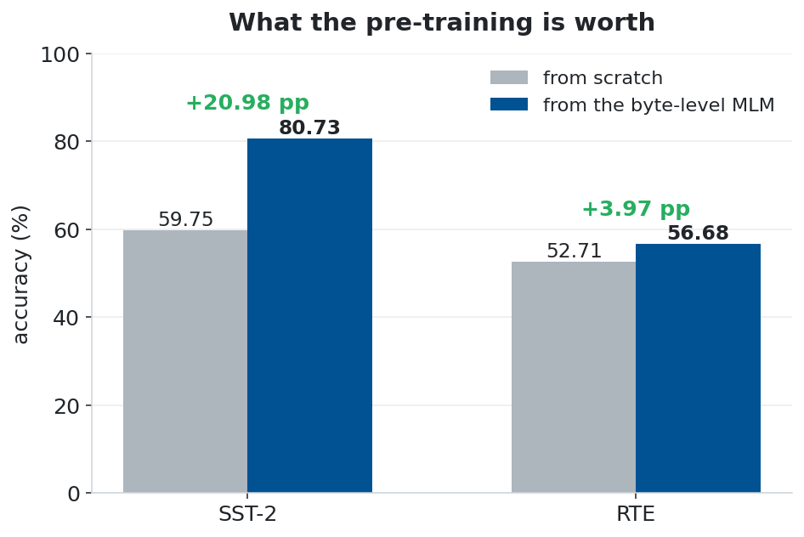
GLUE: What the Pre-training Is Worth
Two tasks fine-tuned twice — once from the MLM checkpoint, once from random weights. Everything else identical.
Why only two controls
What the controls show
• A fine-tuned 80% means nothing on its own: the task might be solvable at 80% from scratch
• One large and one small task — SST-2 has 67,000 examples, RTE has 2,500
• SST-2 goes from 59.75% to 80.73%, a gain of 20.98 points
• RTE goes from 52.71% to 56.68%, a gain of 3.97
• RTE from scratch is the majority class (52.71%): not learned well either way; one run each
F. Gigli C. Vignoli Perceiver & Perceiver IO

Slide 32
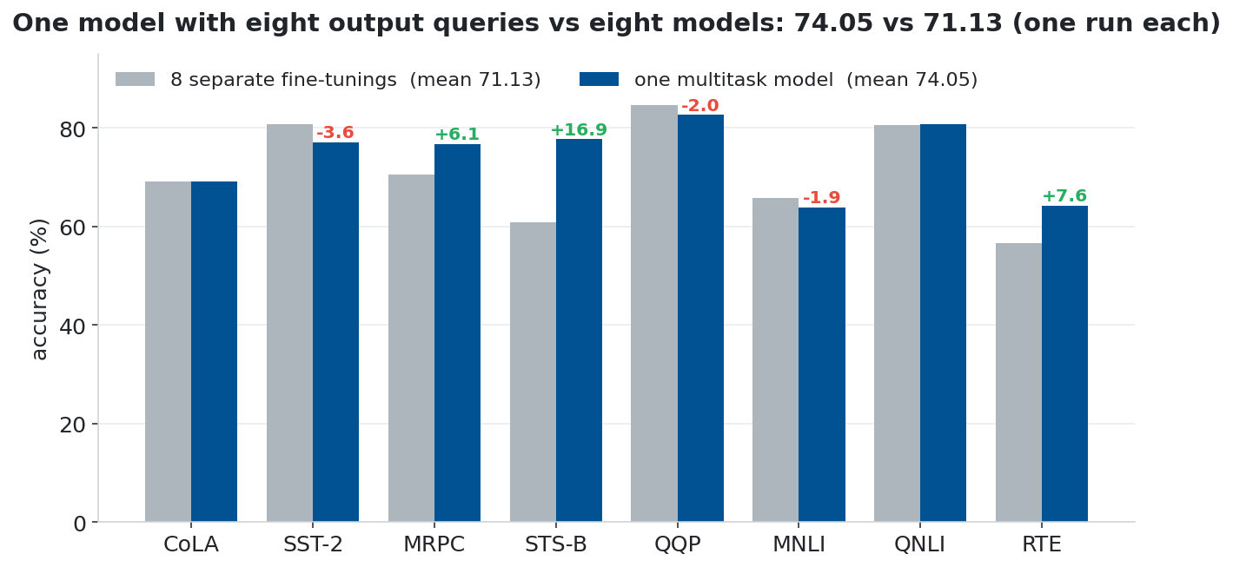
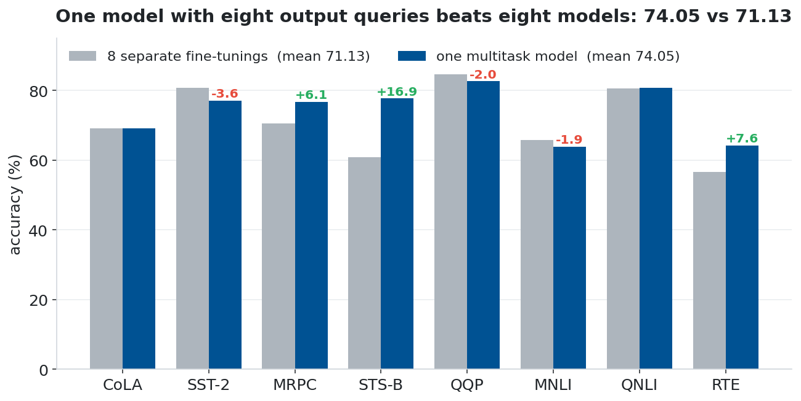
GLUE Multitask: One Model, Eight Output Queries
One model with eight output queries against eight separate fine-tunings — the comparison from Table 2 of the IO paper.
What agrees
Caveats, both ways
• The paper measures 81.8 against 81.0, a gain of 0.8; here 74.05 against 71.13, a gain of 2.92
• The gain sits on the small tasks (STS-B +16.9, RTE +7.6, MRPC +6.1); SST-2, QQP, MNLI lose 1.9–3.6
• Same sign, one run per task, no noise band; with CoLA in Matthews, 16 points below
• The multitask model picks one epoch for all eight tasks; the separate models pick eight
• Ahead on one run per task; CoLA at the majority class in both
• A ninth task costs one query and one linear head
F. Gigli C. Vignoli Perceiver & Perceiver IO

Slide 33
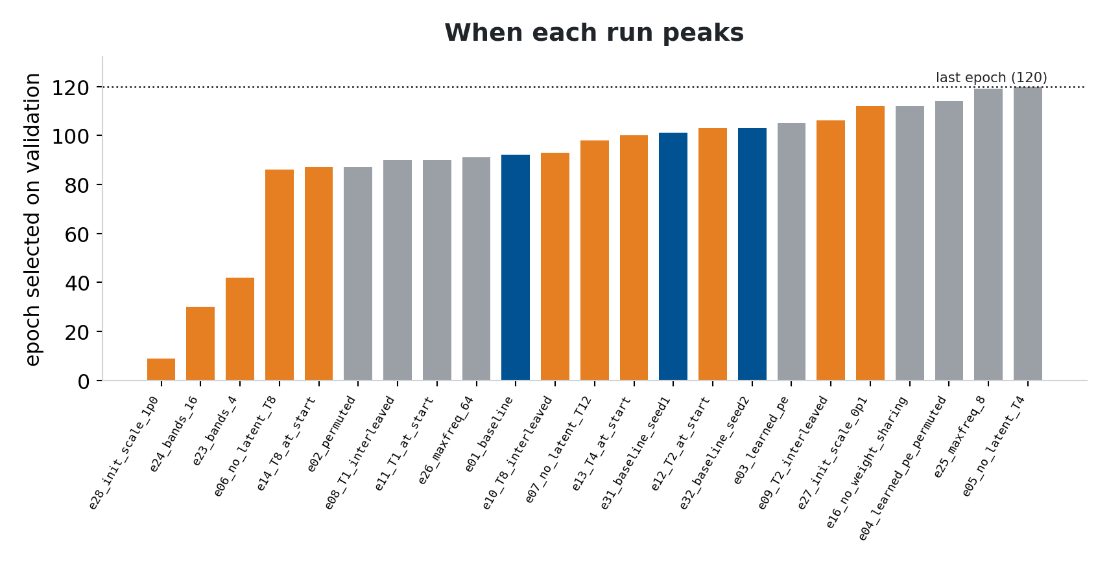
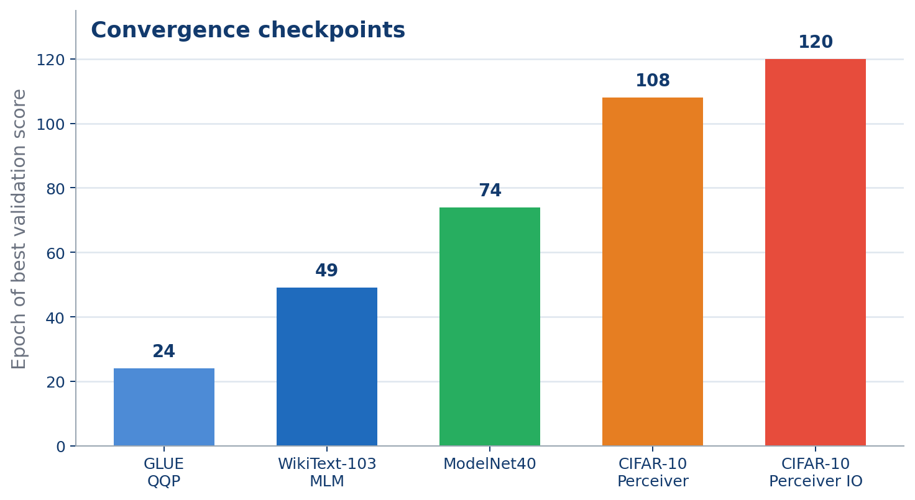
Convergence: Representative Checkpoints
No early stopping: every run trains its full schedule and reports its best epoch (validation; test on ModelNet40).
When each run peaks
What an early peak actually means
• SST-2 fine-tuning peaks at epoch 7 of 10; the MLM at its last, 10 of 10
• Image training uses almost the whole 120-epoch schedule: the Perceiver at 92, ModelNet at 94, the ResNet at 117
• It is a collapse, not fast convergence: e28 peaks at epoch 9 and never recovers
• e23 peaks at 42 with 67.74% on validation and ends the run at 22.54%
• The reported number still comes from the checkpoint chosen on validation, but the instability has to be declared
F. Gigli C. Vignoli Perceiver & Perceiver IO

Slide 34
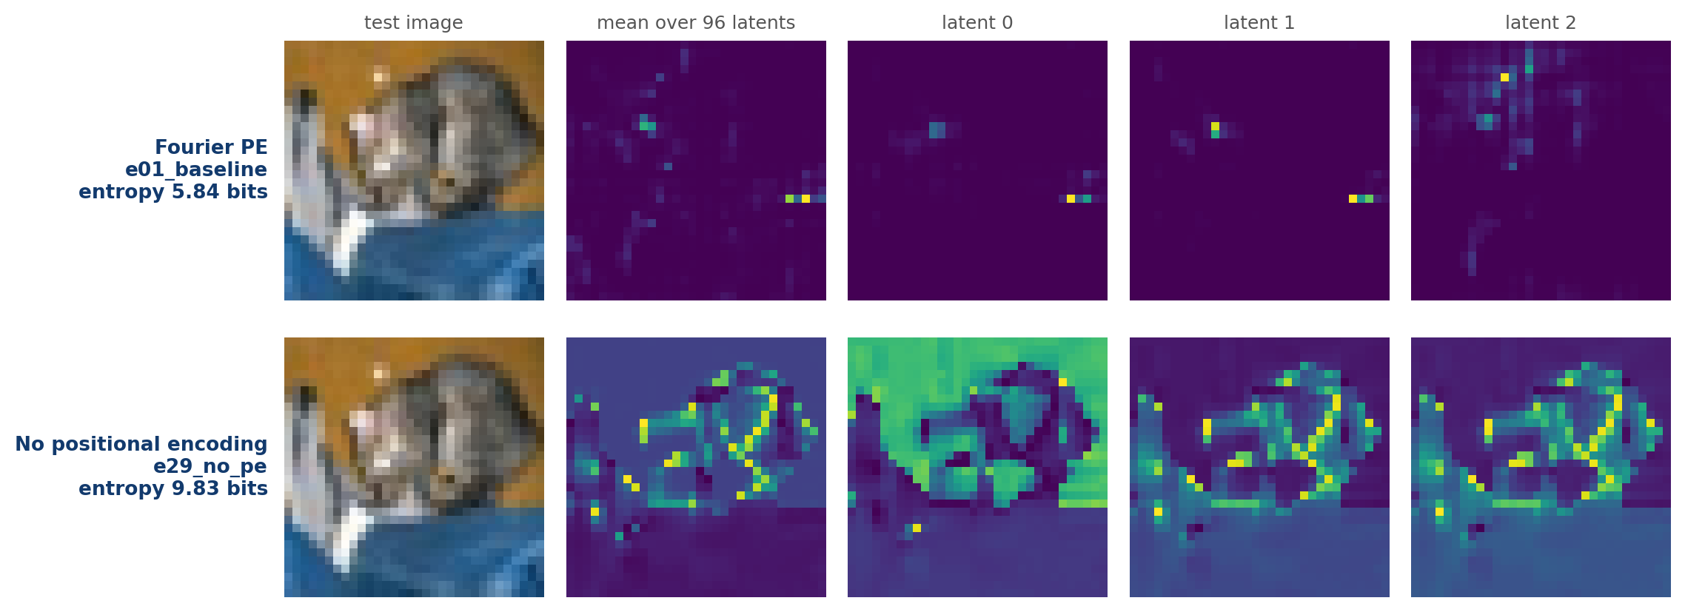
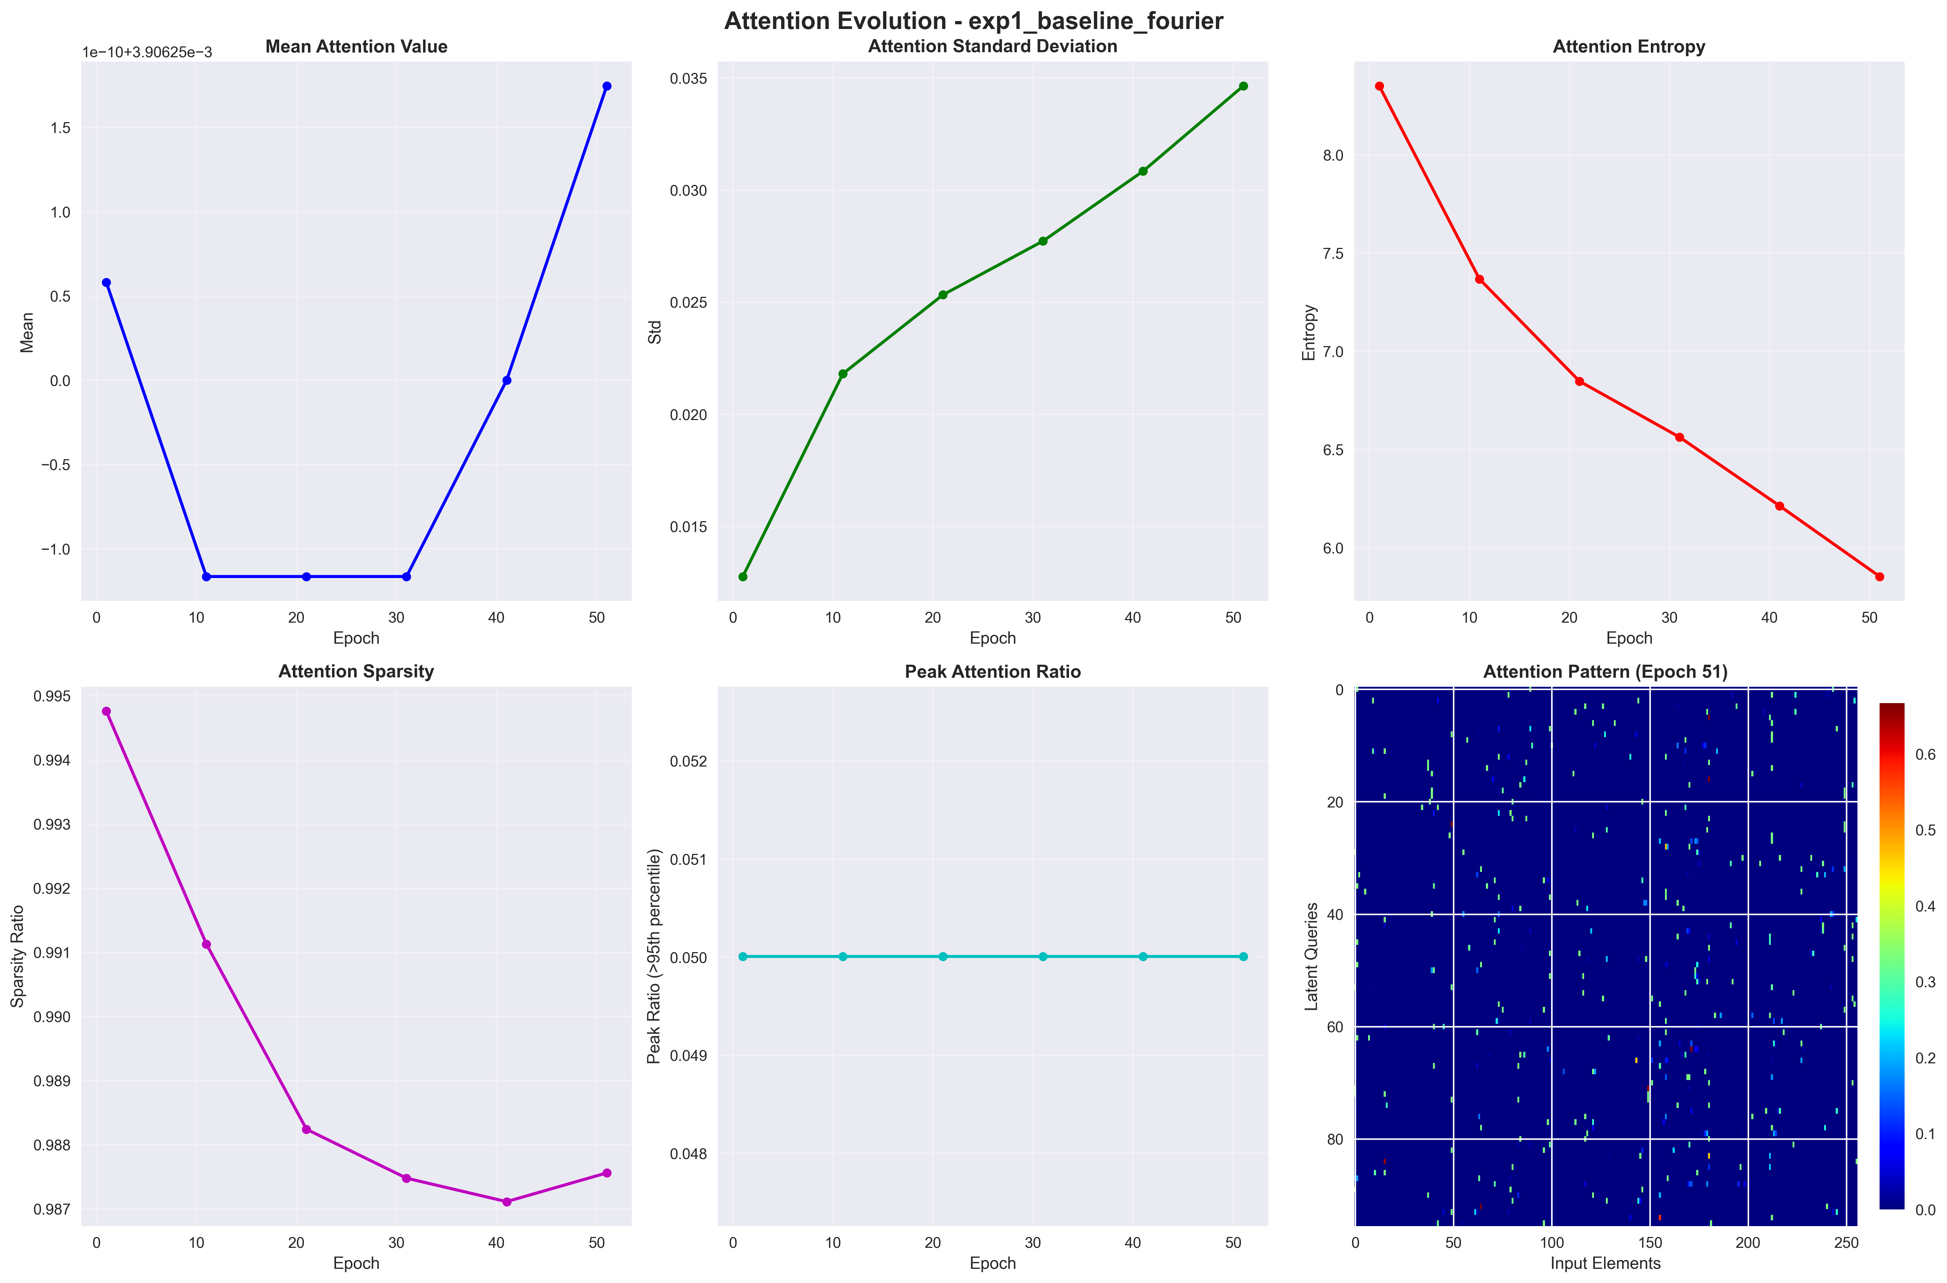
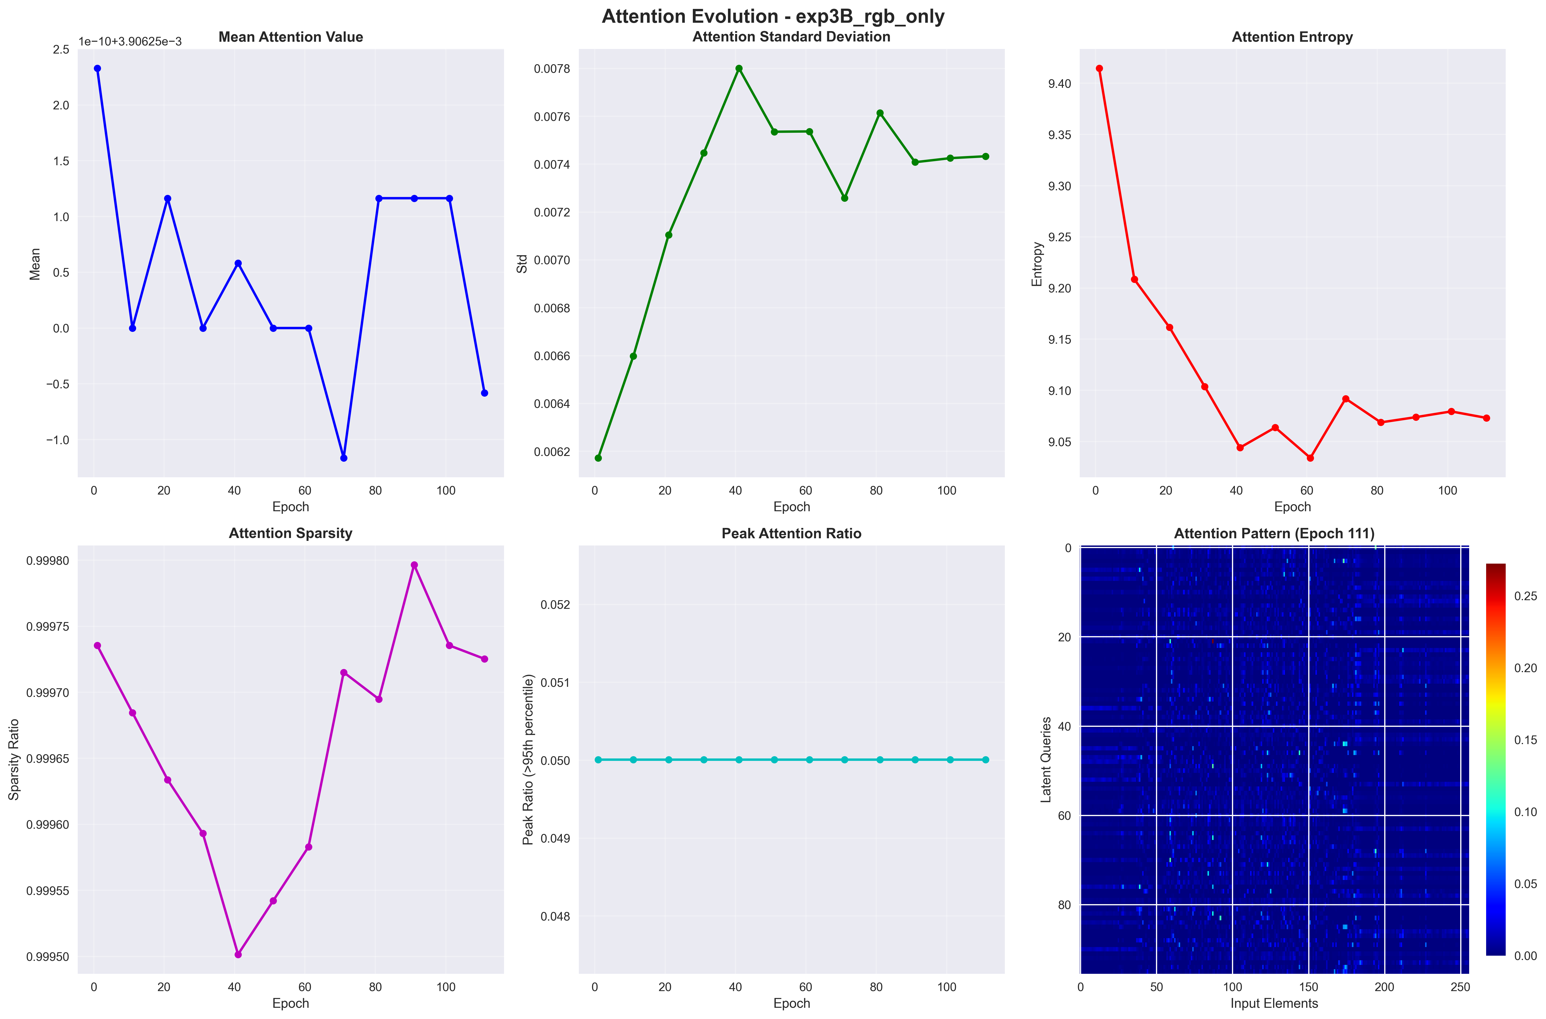
Attention Maps: Where the Latents Look
With coordinates the latents pick locations; without, they can only pick colours.
Fourier PE (e01, 71.63%)
No PE (e29, 32.36%)
• One image: each latent picks a few pixels; latents overlap
• Mean entropy 5.84 bits over 1,024 pixels (uniform: 10 bits)
• Same-colour pixels are indistinguishable: attention follows colour boundaries
• 9.83 bits, 98% of uniform — spread over the whole image
F. Gigli C. Vignoli Perceiver & Perceiver IO

Slide 35
Comprehensive Results Summary
Forty-two runs, all completed. Every number below traces to a log, a results.json or the papers.
Modality | Model | Best result | Reference | Runs
Images (CIFAR-10) | Perceiver | 72.91% (in band) | 93.61% ResNet-18 | 24
Images (CIFAR-10) | Perceiver IO | 71.79% | — | 2
Point clouds (ModelNet40) | Perceiver | 87.36% | 85.7% paper | 3
Text (WikiText-103) | Perceiver IO | 86.68% MLM | 42.96% lookup | 1
NLU (GLUE, 8 tasks) | Perceiver IO | 71.13 / 62.49 MCC | 81.0 paper | 11
What is measured
The scope of the campaign
• ModelNet40 above the paper: +1.66 (last epoch +0.73)
• Byte-level MLM: 86.68%, 44 above a neighbour lookup
• Multitask 74.05 vs 71.13 separate: one run each, no noise band
• 42 runs in a declarative registry, all of them completed
• Three modalities: 2D images, 3D point clouds, raw bytes
• 55 tests passing, and a 2.78-point noise band measured before any comparison was read
F. Gigli C. Vignoli Perceiver & Perceiver IO

Slide 36
Gap vs Original Papers
Point clouds: above the paper's number. Images: a CNN with its own recipe is 22 points ahead.
Source | Acc.
Original paper | 85.70%
This implementation | 87.36%
Difference | +1.66 pp
Source | Acc.
ResNet-18, own recipe | 93.61%
This Perceiver | 71.63%
Difference | -21.98 pp
ModelNet40 — point clouds
CIFAR-10 — images
• 85.70% in the paper, 87.36% here: 1.66 points above, 0.73 at the last epoch
• Epoch picked on test, as in the paper; other config, no noise band
• 93.61% for a ResNet-18 with its own SGD recipe, 71.63% for the Perceiver: 21.98 below
• The paper does not benchmark CIFAR-10, so the reference had to be measured rather than quoted
On ImageNet the paper edges ResNet-50 by 0.4 points (4.5 over its Fourier-feature version); data scale is not varied here.
F. Gigli C. Vignoli Perceiver & Perceiver IO

Slide 37
Hardware Limitations & Design Choices
Every limitation below is one GPU instead of a TPU pod. The mechanism is the paper's; the budget is not.
Parameter | Papers (DeepMind) | This project
Hardware | TPUs (Perceiver: not stated; IO: 64–256) | 1 NVIDIA RTX 3080
Batch size | 512–8192 | 32–64
Latents (N) | 512 (ImageNet), 2048 (IO flow) | 96 (images) · 128 (point clouds, text)
Model size | 44.9M (Perceiver), 201M (IO text) | 10.2–23.3M params
Pre-training corpus | Wikipedia + C4 (201M-param IO) | WikiText-103 (18.9M-param IO)
What it cost us
What we did about it
• Init scale 1.0 collapses our run; in the paper (LAMB too) it costs ~1 point
• Fewer latents mean less representational capacity
• 9 of 21 CIFAR-10 ablations sit inside the band (11 vs seed mean)
• GLUE, CoLA in Matthews: 62.49 against the paper's 81.0
• Weight sharing: unsharing (3× weights) gained nothing measurable
• Three seed replicas, to measure the noise before reading any effect
• An epoch budget scaled per task size on GLUE, from 3 to 30
• A convolutional baseline, so the numbers can be read at all
F. Gigli C. Vignoli Perceiver & Perceiver IO

Slide 38
Possible Improvements
What we would do next, in rough order of how much it would move the numbers.
Architecture
Training
Data and tasks
Analysis
• More latents (N = 256+) with gradient checkpointing
• Multi-scale cross-attention, coarse to fine
• Relative position encodings such as RoPE or ALiBi
• A deeper decoder for structured outputs
• Larger effective batches via gradient accumulation
• More seeds per ablation, for a better noise estimate
• Longer schedules
• Stronger augmentation: CutMix, MixUp
• ImageNet pre-training for vision
• Longer byte-level pre-training: more epochs, larger corpus
• Joint multi-modal training
• An audio modality
• Layer-wise attention probing
• Clustering the latent space
• A systematic hyperparameter search
• A comparison with Linformer and Performer
F. Gigli C. Vignoli Perceiver & Perceiver IO

Slide 39
Empirical Summary
Everything measured; only CIFAR-10 has a noise band.
What worked
What did not
• One architecture across images, point clouds and raw bytes
• ModelNet40 above the paper: 87.36% against 85.7%
• The byte-level MLM works: 86.68%, 44 points above a neighbour lookup
• Pre-training transfers: SST-2 from 59.75% to 80.73%
• Multitask 74.05 vs 71.13: same sign as the paper, no noise band
• A ResNet-18, own SGD recipe, reaches 93.61% against 71.63%
• The latent init scale destabilises training: at 1.0 the run collapses to 52.08%
• CoLA is the majority class; MRPC beats it by 9 of 408
• Byte-level input means very long sequences for the same text
• Nine of the 21 CIFAR-10 ablations are indistinguishable from noise, eleven against the seed mean
Removing the positional encoding is the largest effect measured: 71.63% to 32.36%. Permuting the pixels costs 2.68 points, inside the band. Position enters through the encoding, not the grid.
F. Gigli C. Vignoli Perceiver & Perceiver IO

Slide 40
Conclusions
What the architecture gives, and what it still costs at this scale.
What it gives
What it costs
• One architecture for images, point clouds and text
• Complexity linear (by construction, not measured)
• Weight sharing: unsharing (3× weights) gained nothing measurable
• No CNN or RNN assumptions about the domain
• Output queries: a new task costs one query and one linear head
• At this scale prior plus recipe are worth 21.98 points
• Everything depends on the positional encoding: 39.27 points without it
• GLUE: 62.49 with CoLA in Matthews vs 81.0, at a tenth of the parameters
• Init scale 1.0 collapses training (paper: ~1 point)
• Half the image ablations cannot be told apart from noise
The Perceiver's advantage is not accuracy but having no domain prior. At CIFAR-10 scale prior plus recipe are worth 22 points; on ImageNet the paper shows the prior stops paying.
F. Gigli C. Vignoli Perceiver & Perceiver IO

Slide 41
Thank you!
Questions?
Francesco Gigli · Corso Vignoli
Università degli Studi di Firenze · Course B031278 — Deep Learning
Code and reproduction instructions shared with the course

